Slide 1
U.S. Submarine Veterans
Charitable Foundation
2026-27 Scholarship Awardees Showcase
Honoring 80 outstanding students

Slide 2
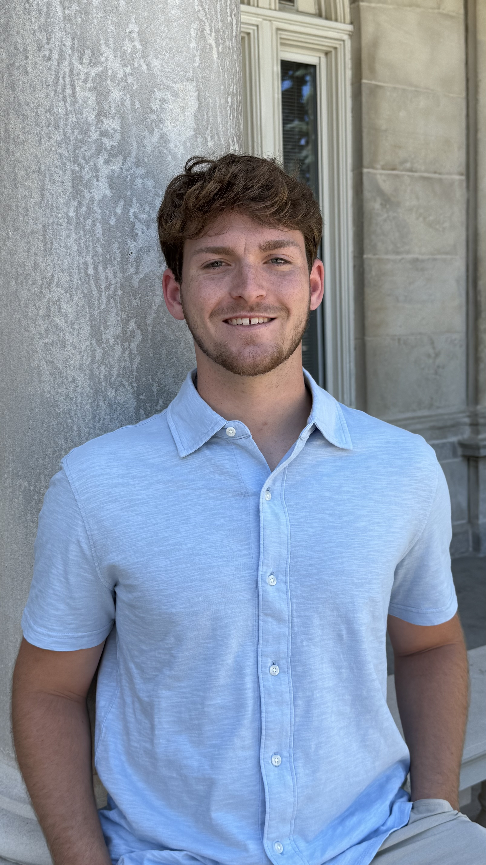
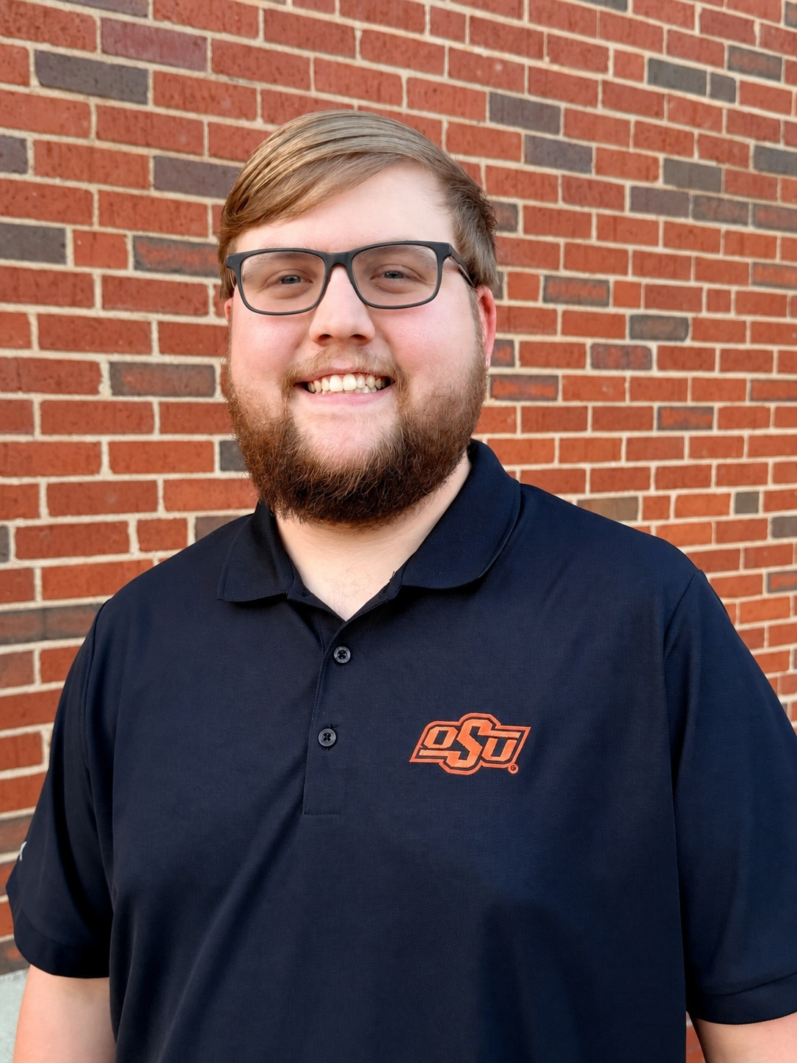
Scholarship Awardees • 1 of 40
Insert photo
Insert photo
Brandon Abbott
Alexander Allen
Olivet Nazarene University
Oklahoma State University

Slide 3
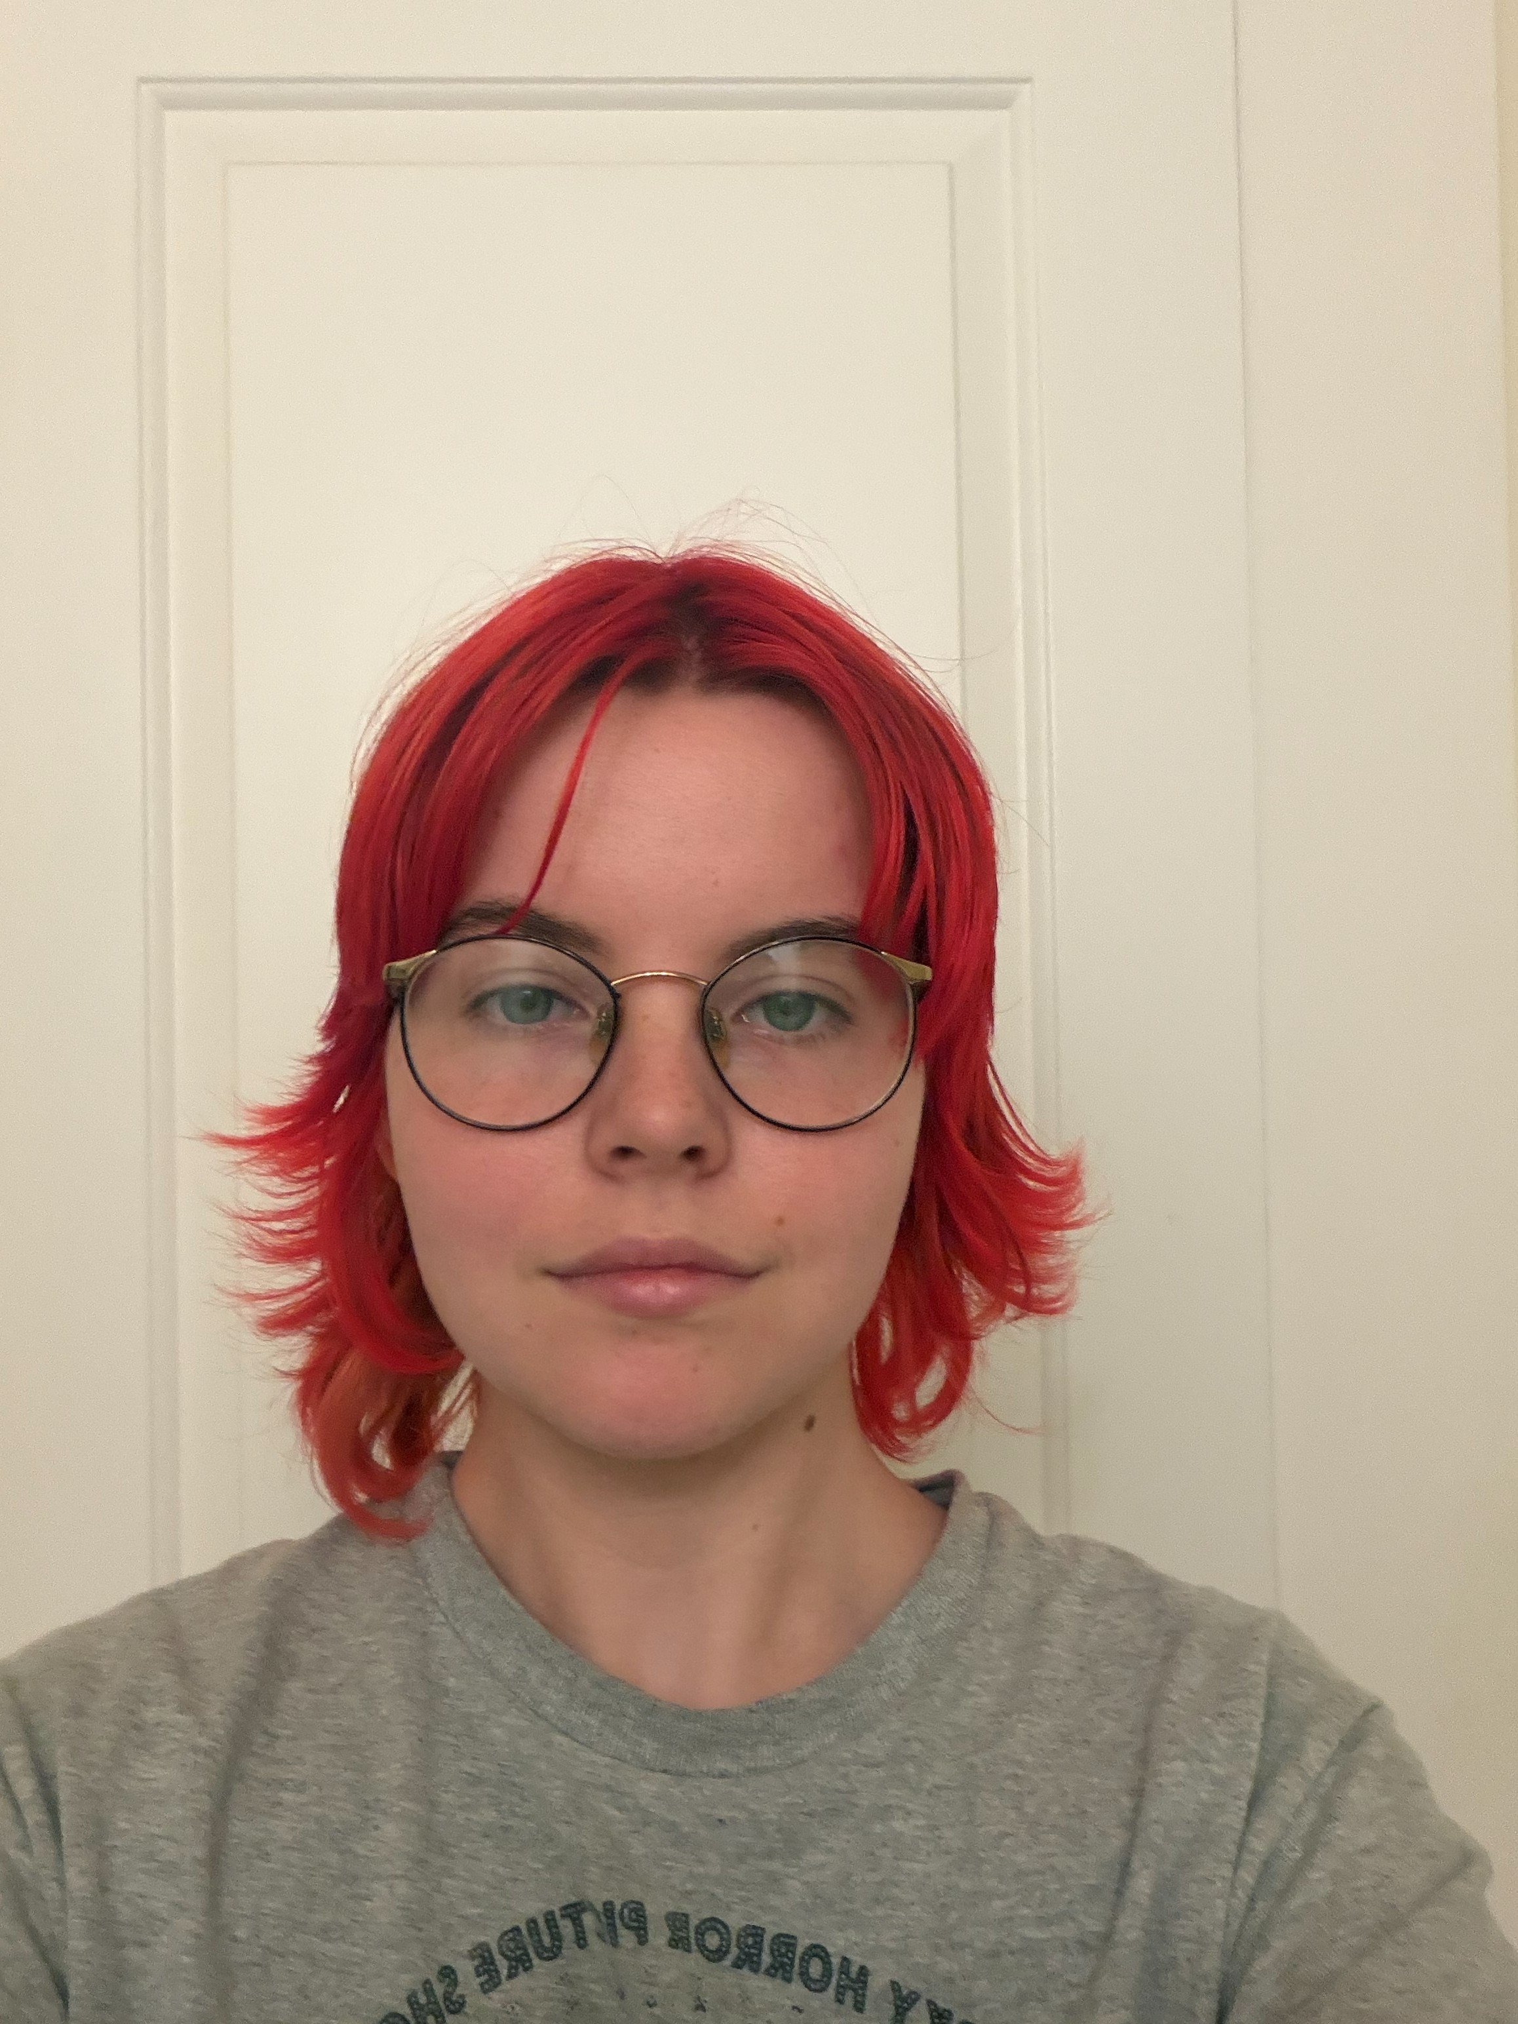
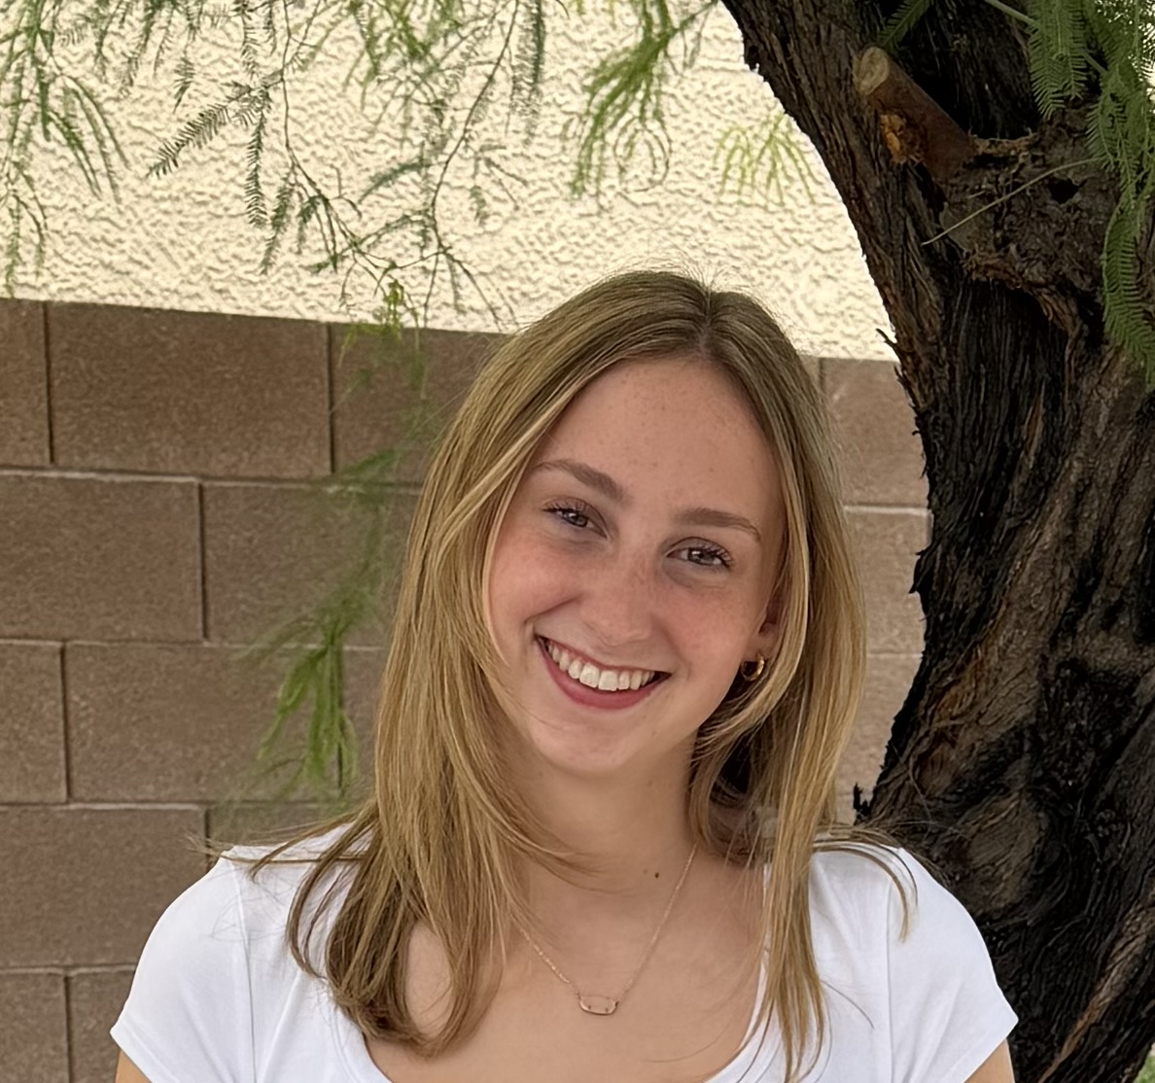
Scholarship Awardees • 2 of 40
Insert photo
Insert photo
Madison Arner
Maia Atkinson
Utah Tech University
University of Tennessee

Slide 4
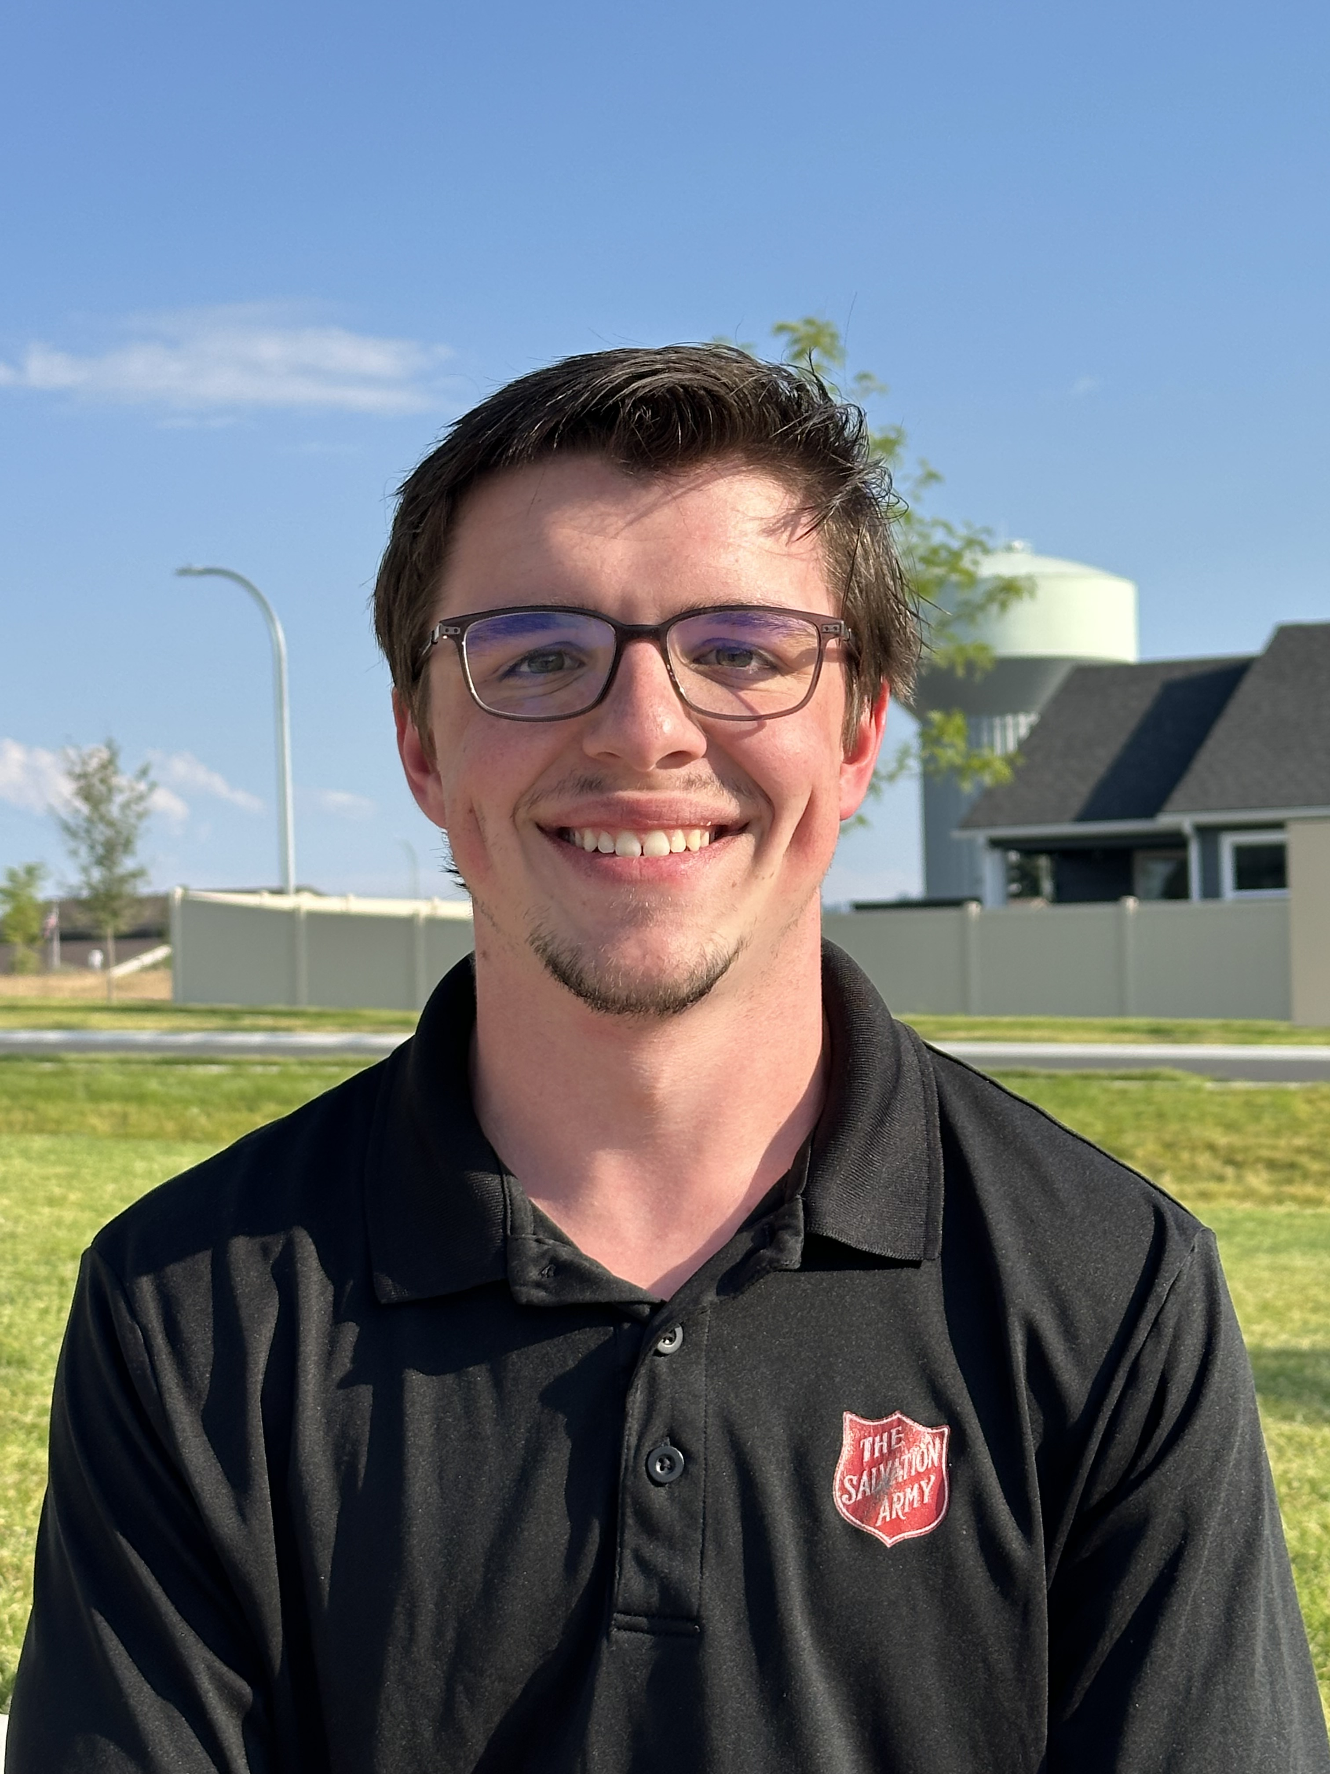
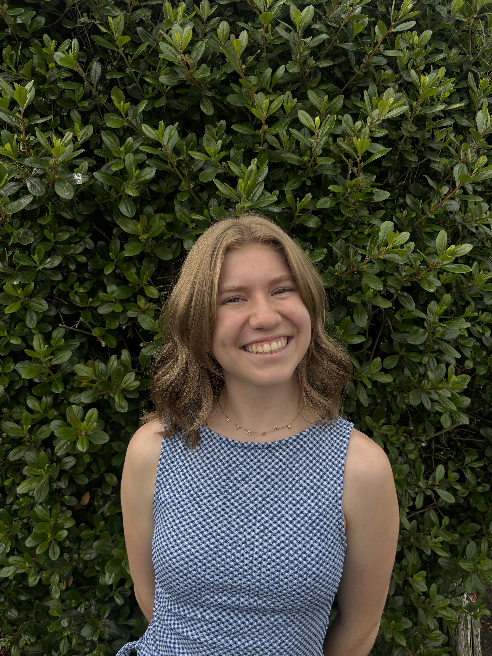
Scholarship Awardees • 3 of 40
Insert photo
Insert photo
Brady Bailey
Hannah Baugh
North Idaho College
Clemson University

Slide 5
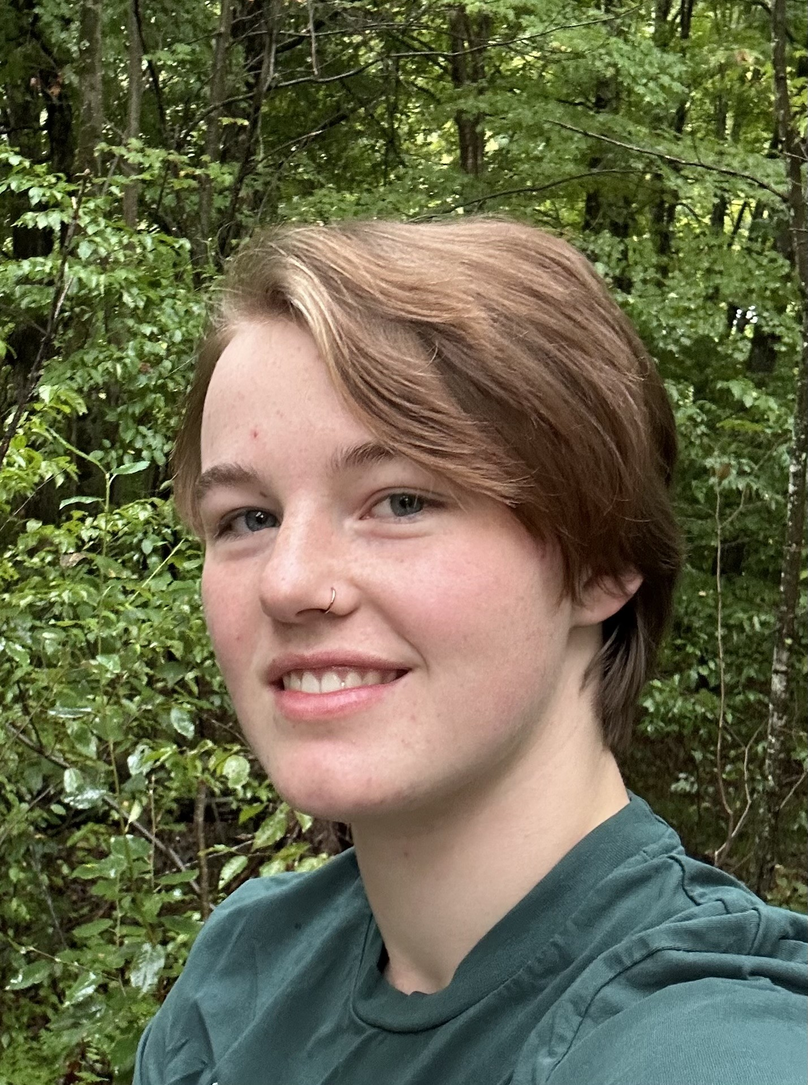
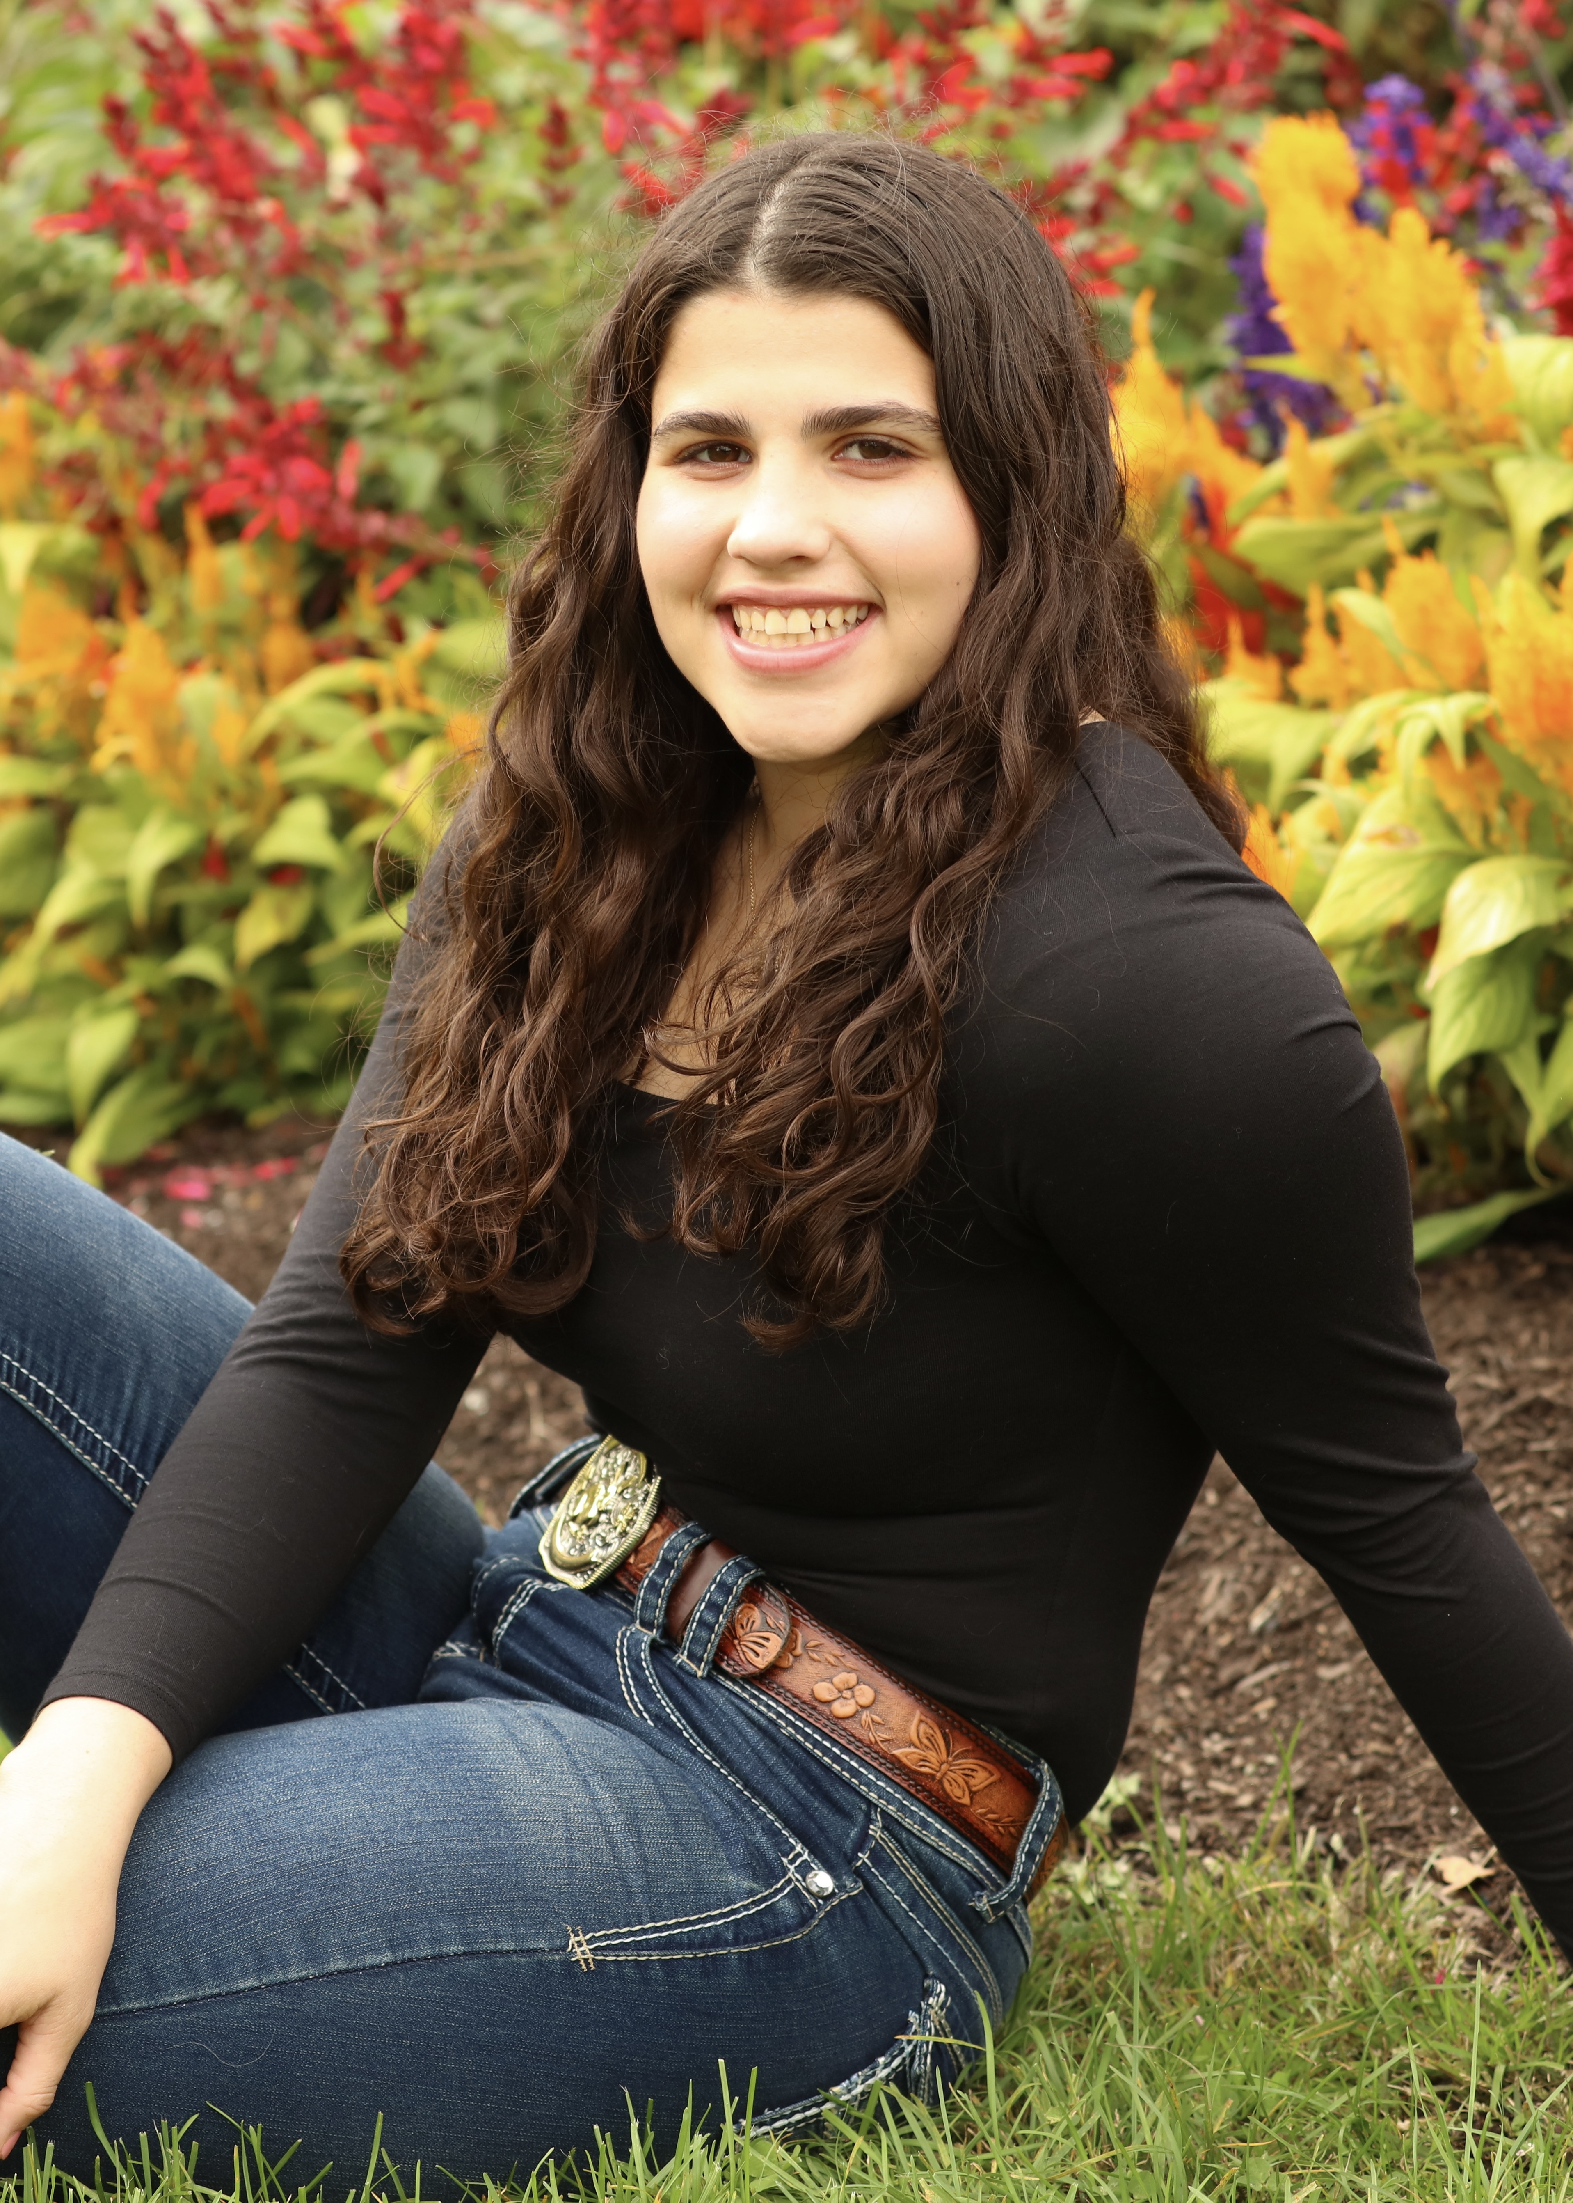
Scholarship Awardees • 4 of 40
Insert photo
Insert photo
Quincy Boardman
Julia Bodien
University of Vermont
LeMoyne College

Slide 6
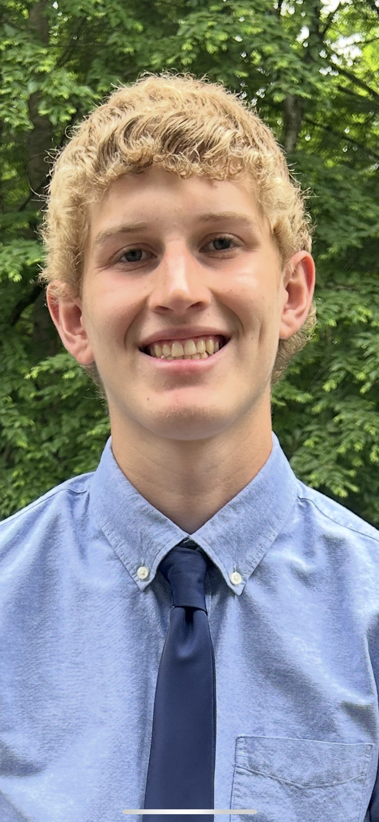

Scholarship Awardees • 5 of 40
Insert photo
Insert photo
Benjamin Carlson
Daniela Castillo
University of Connecticut
Pacific Lutheran University

Slide 7
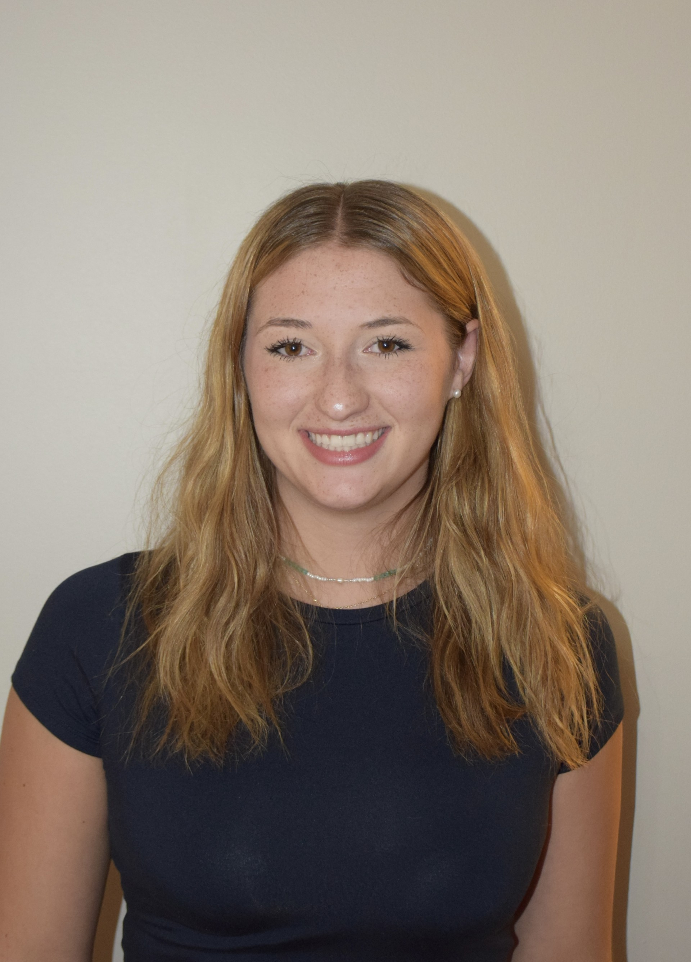
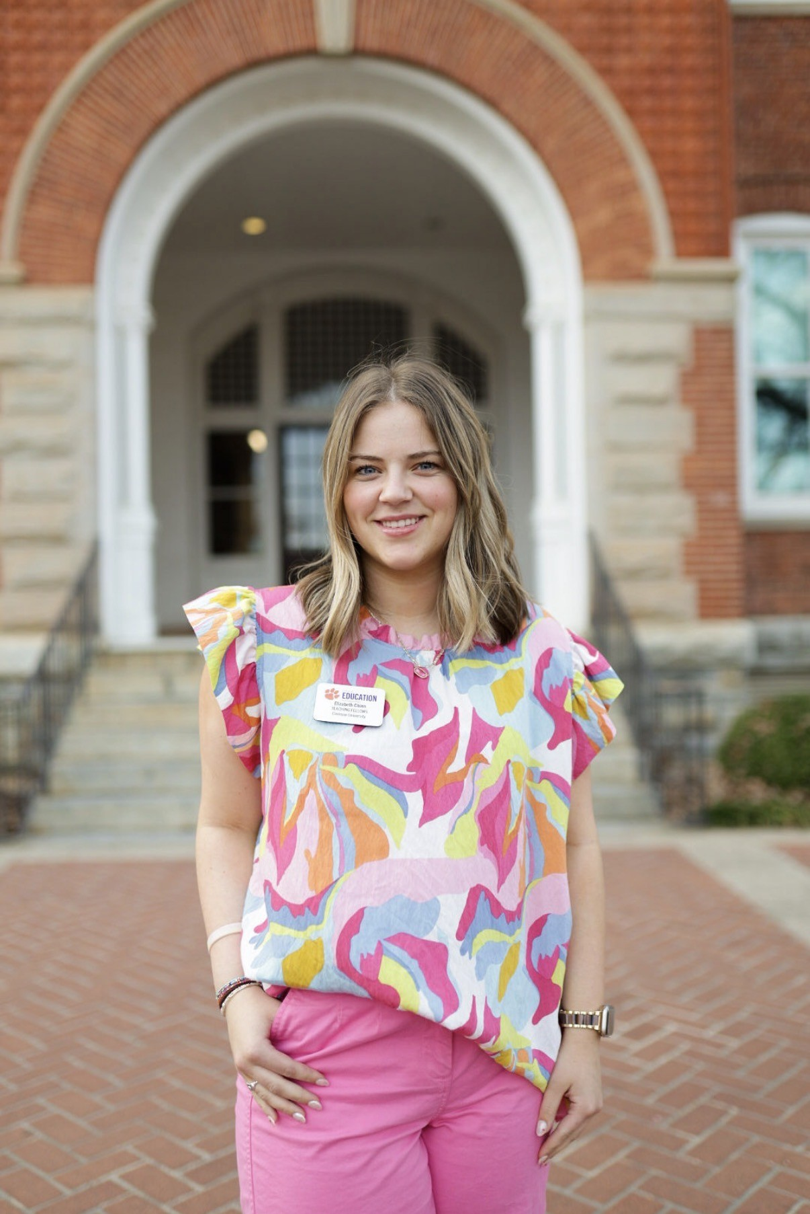
Scholarship Awardees • 6 of 40
Insert photo
Insert photo
Grace Cervone
Elizabeth Chinn
University of Pittsburgh
Clemson University

Slide 8
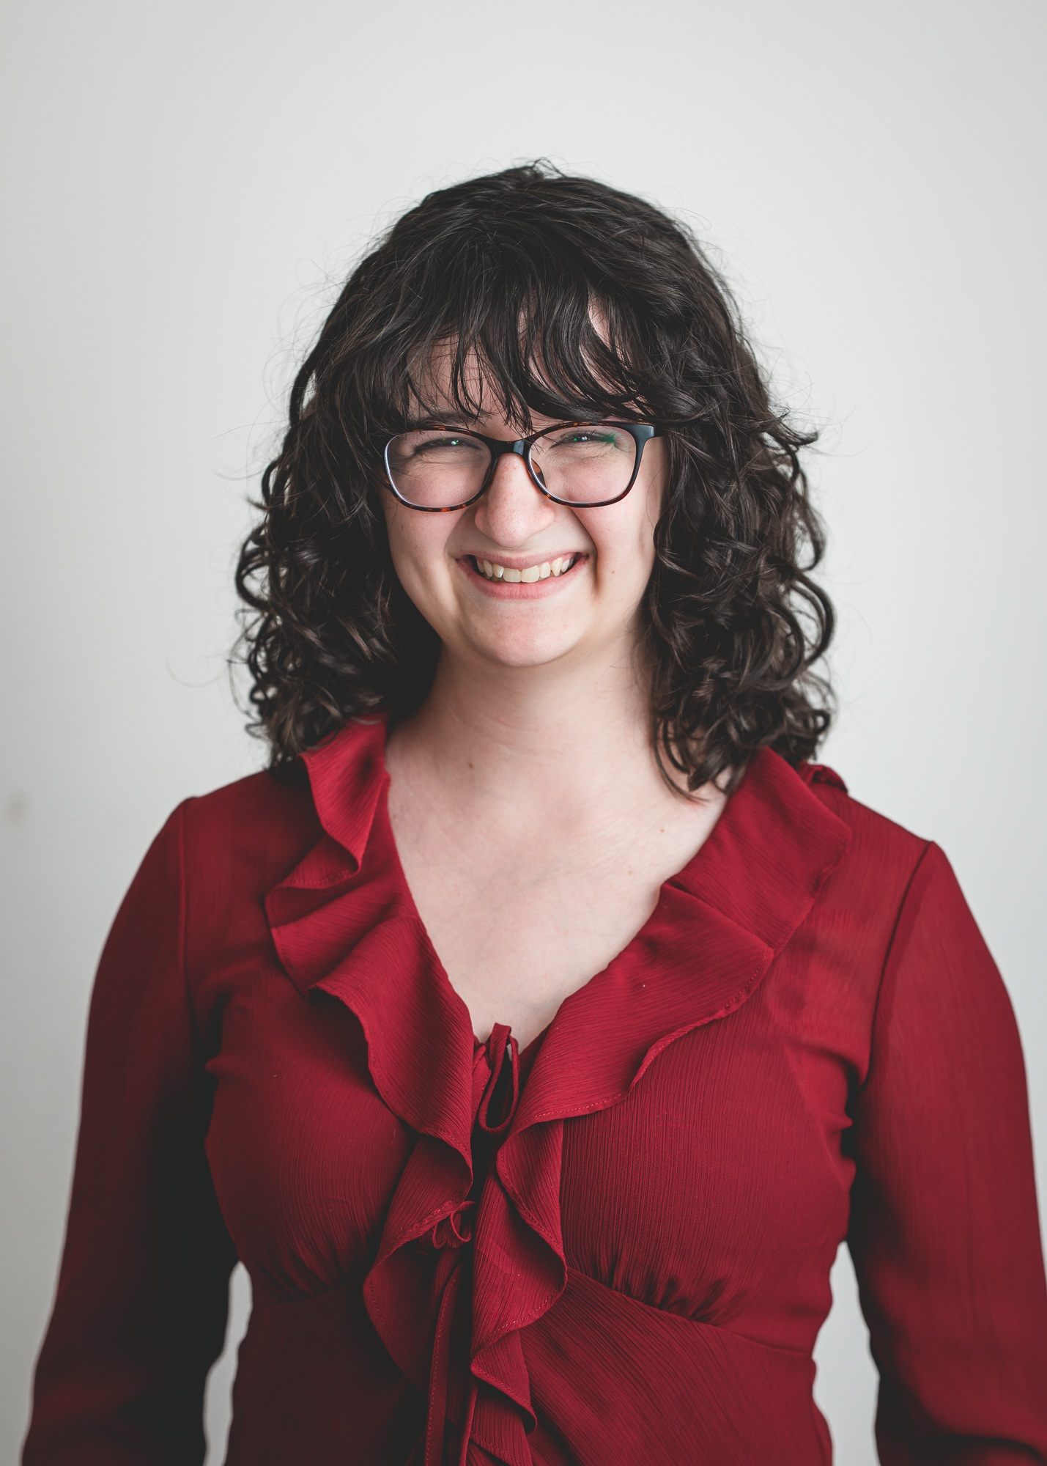
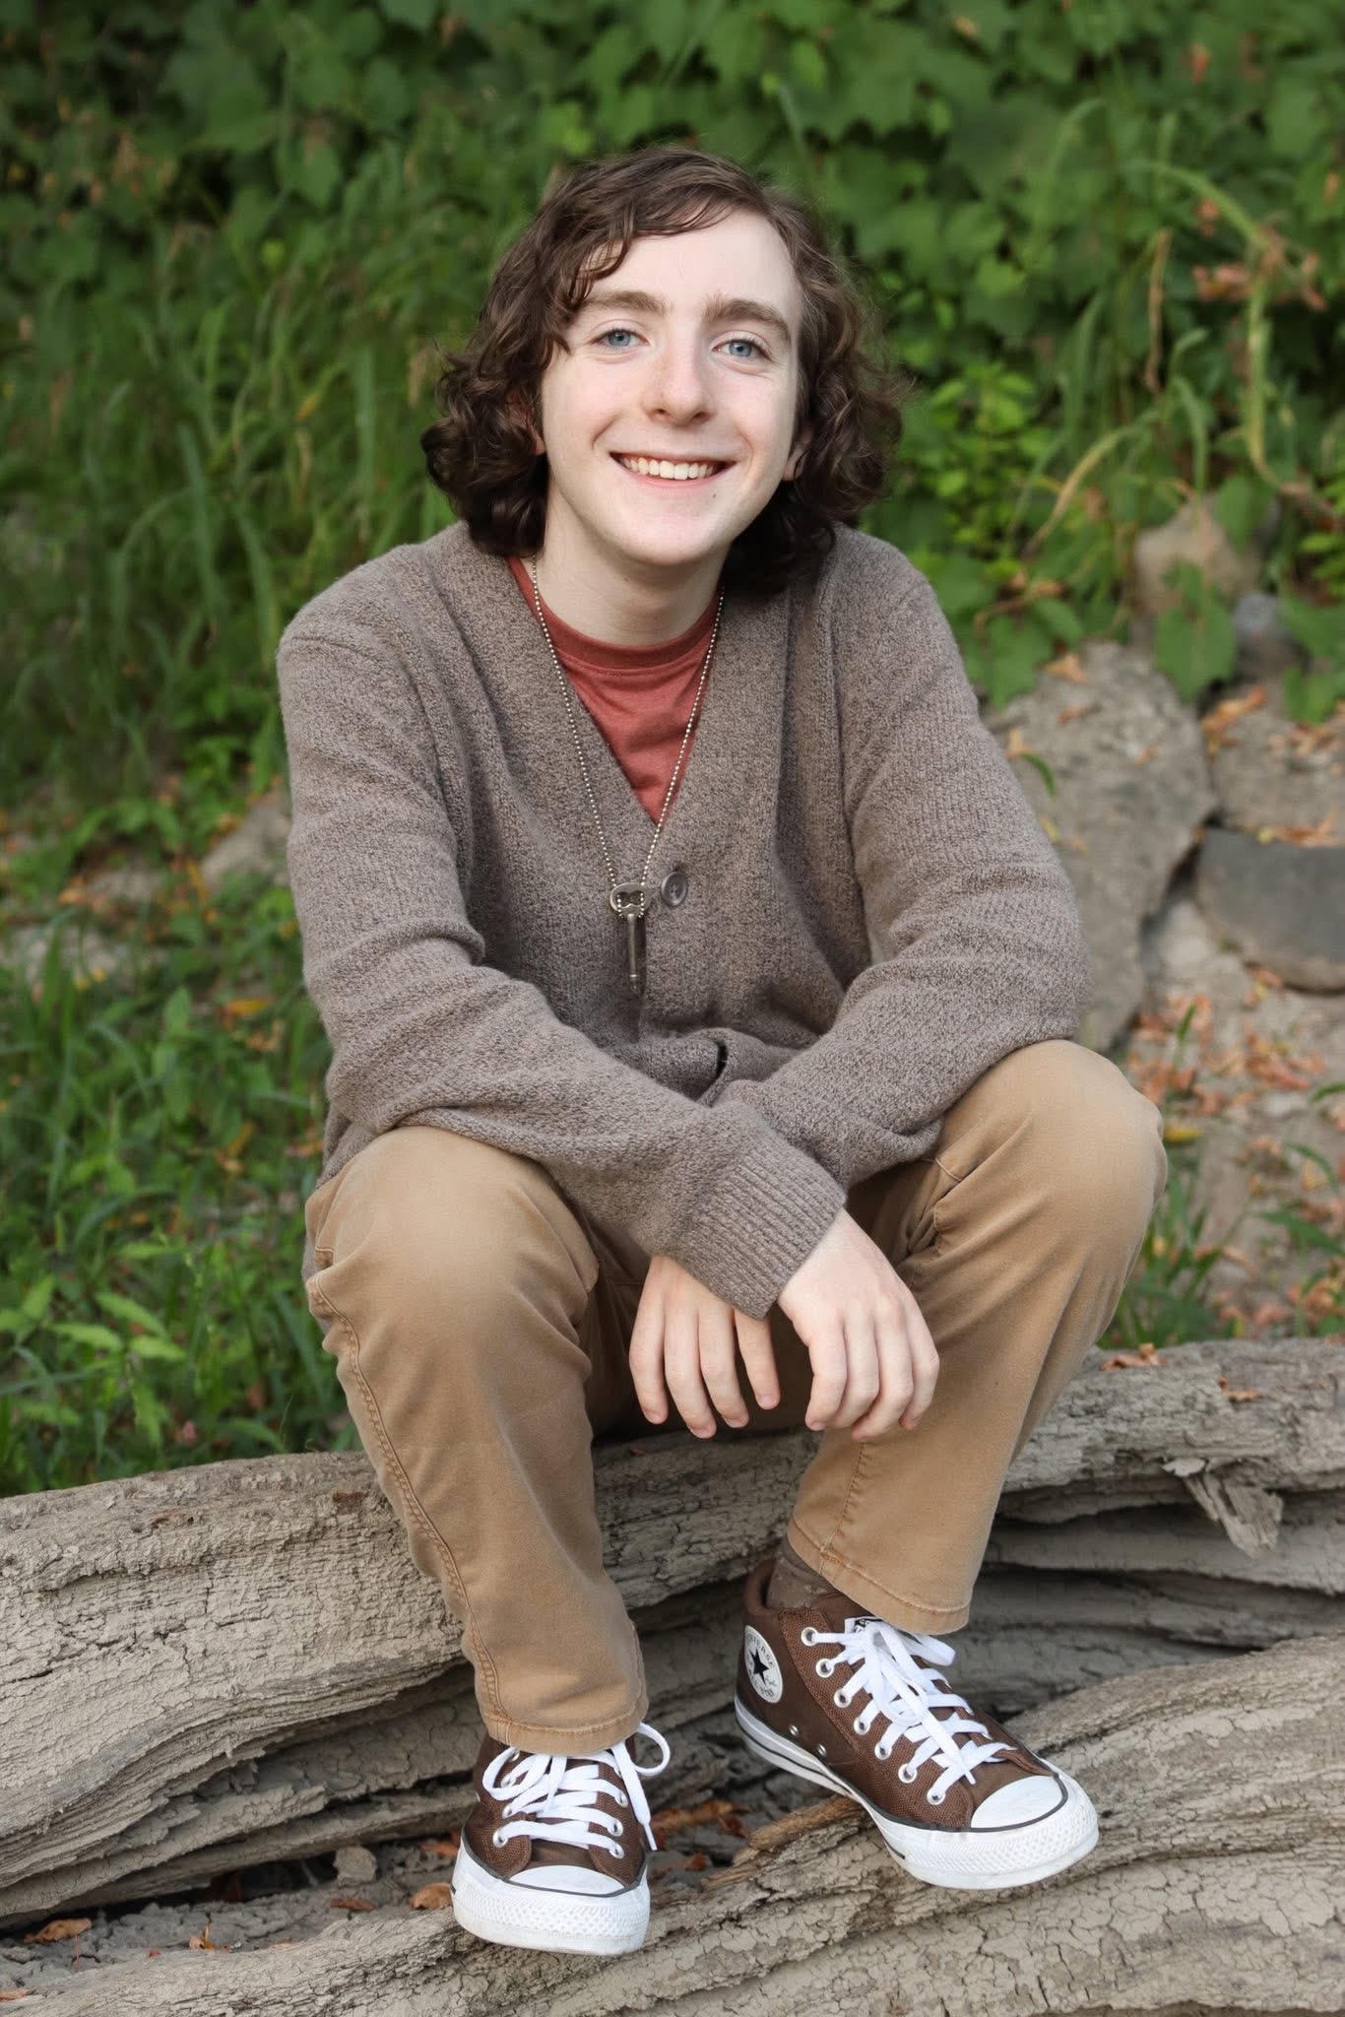
Scholarship Awardees • 7 of 40
Insert photo
Insert photo
Claire Damiano
Sullivan Daniels
Marist University
Champlain College

Slide 9
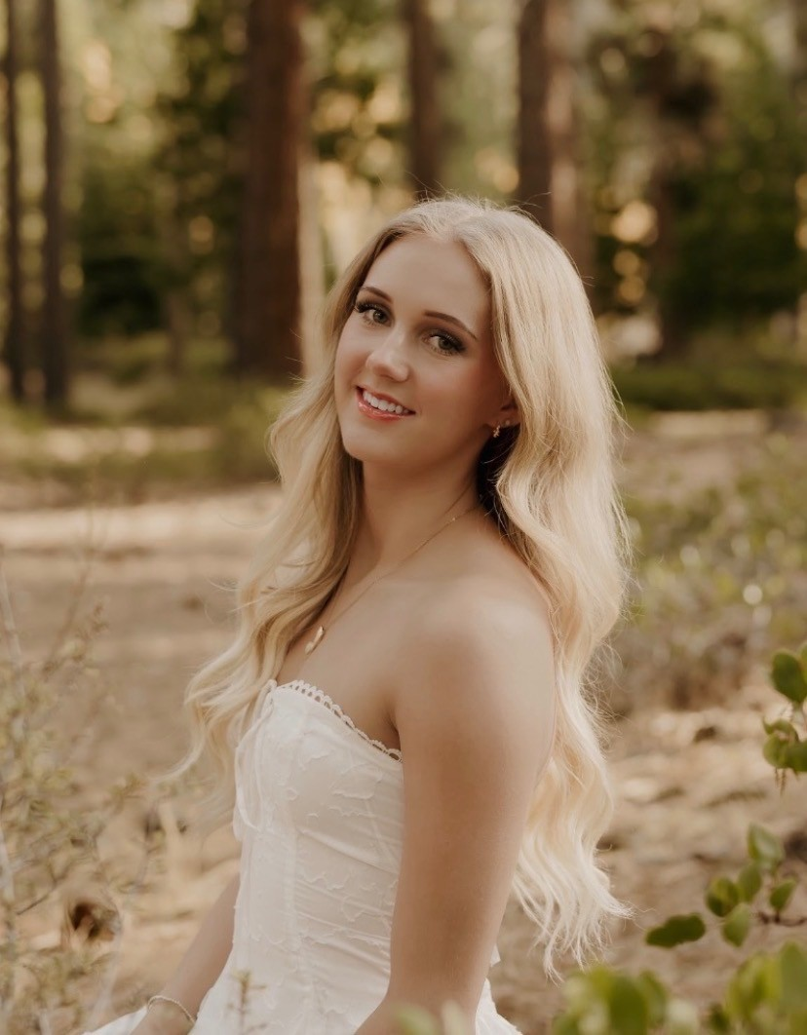
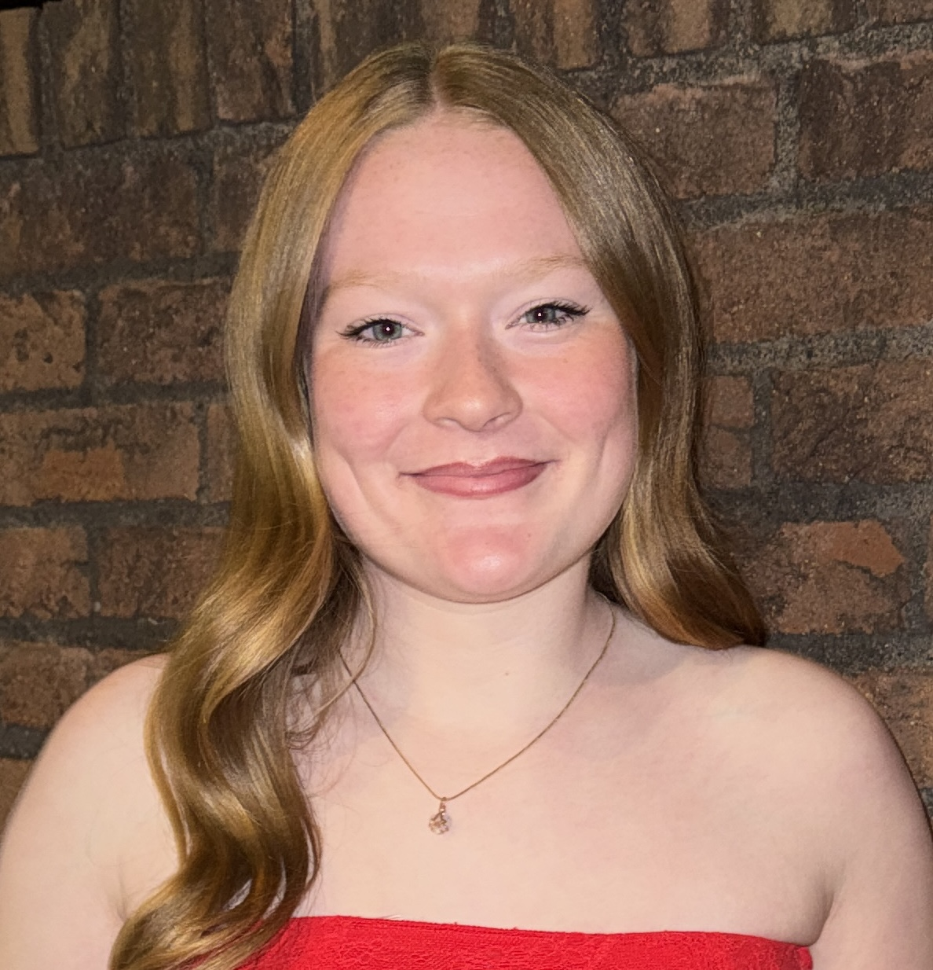
Scholarship Awardees • 8 of 40
Insert photo
Insert photo
Juliann Davies
Natalie DeMoor
University of Nevada-Reno
University of Toledo

Slide 10
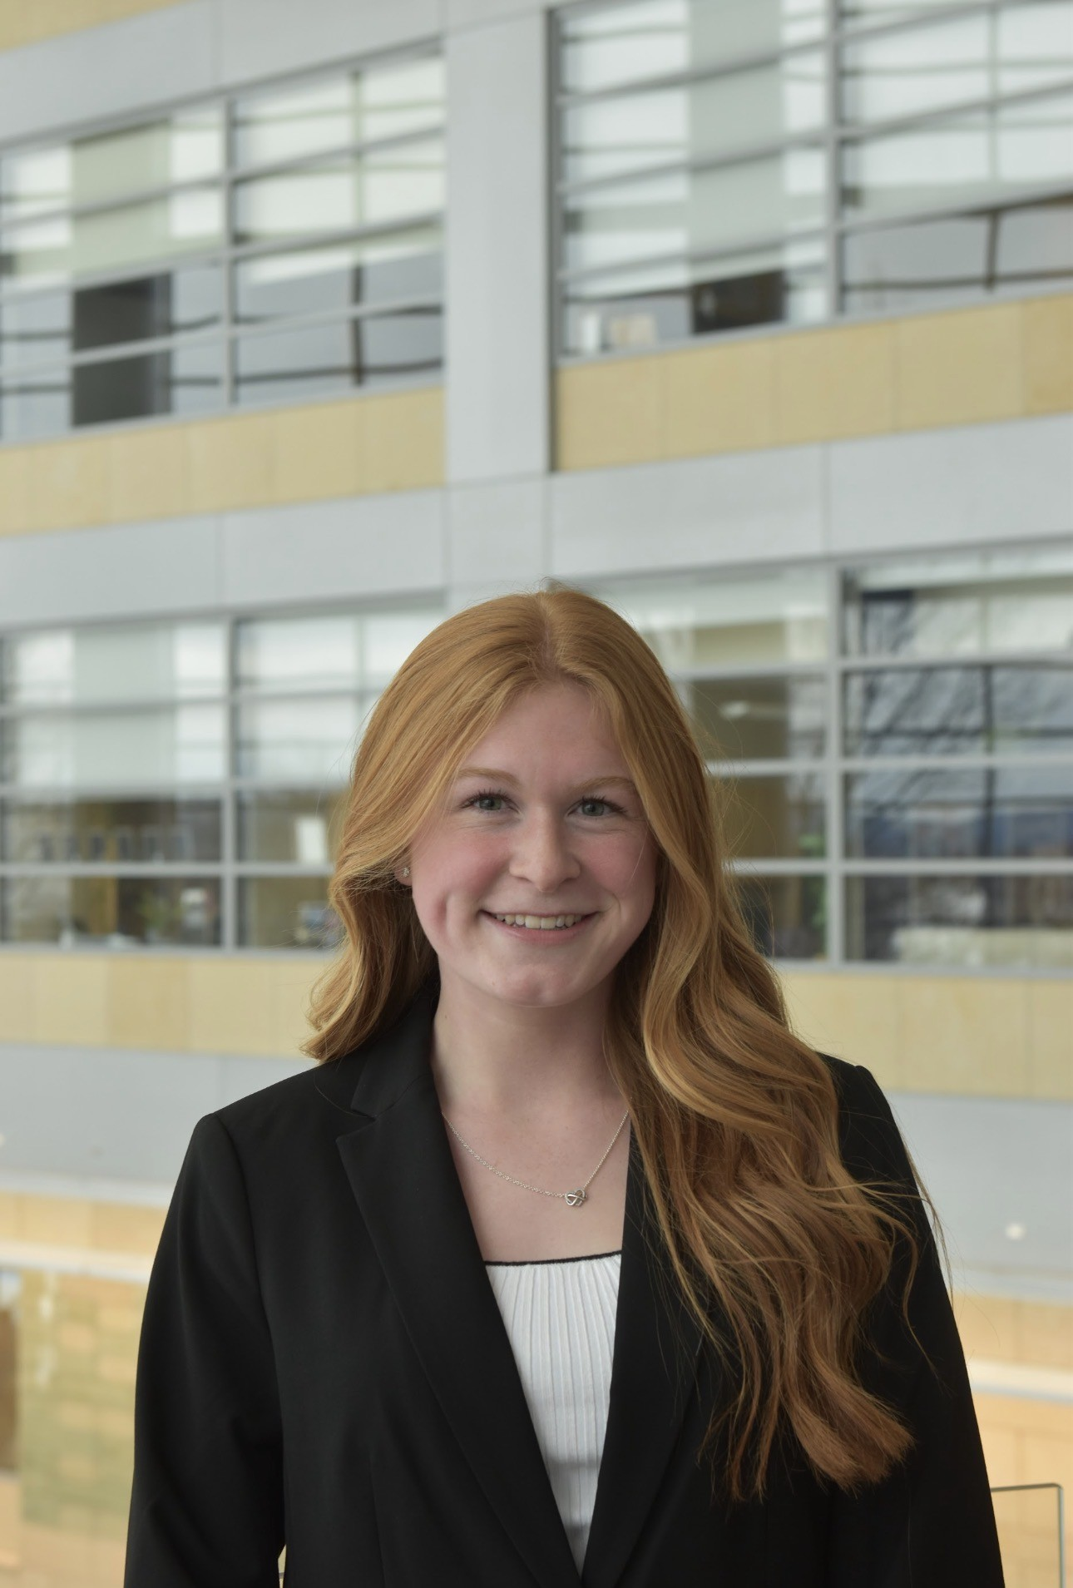
Scholarship Awardees • 9 of 40
Insert photo
Insert photo
Hannah Diener
Delaney Dodge
University of Florida
Penn State University

Slide 11
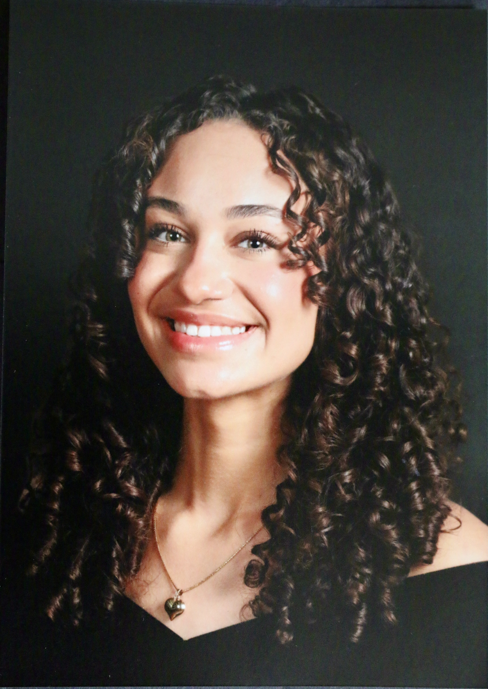
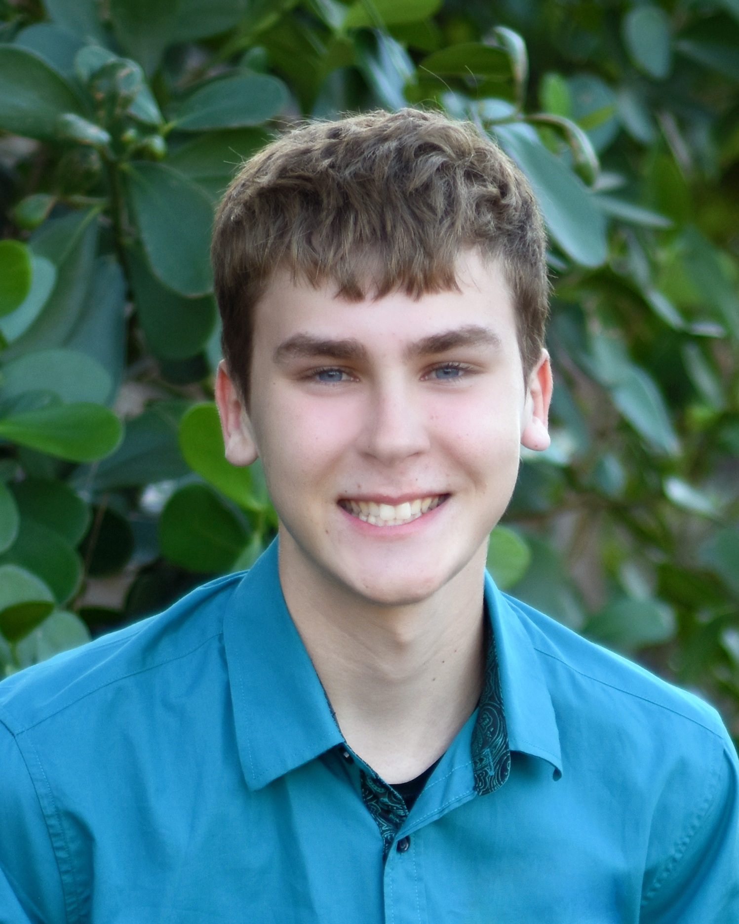
Scholarship Awardees • 10 of 40
Insert photo
Insert photo
Simone Dotson
Cayden Draeger
McGill University
Florida Southern College

Slide 12
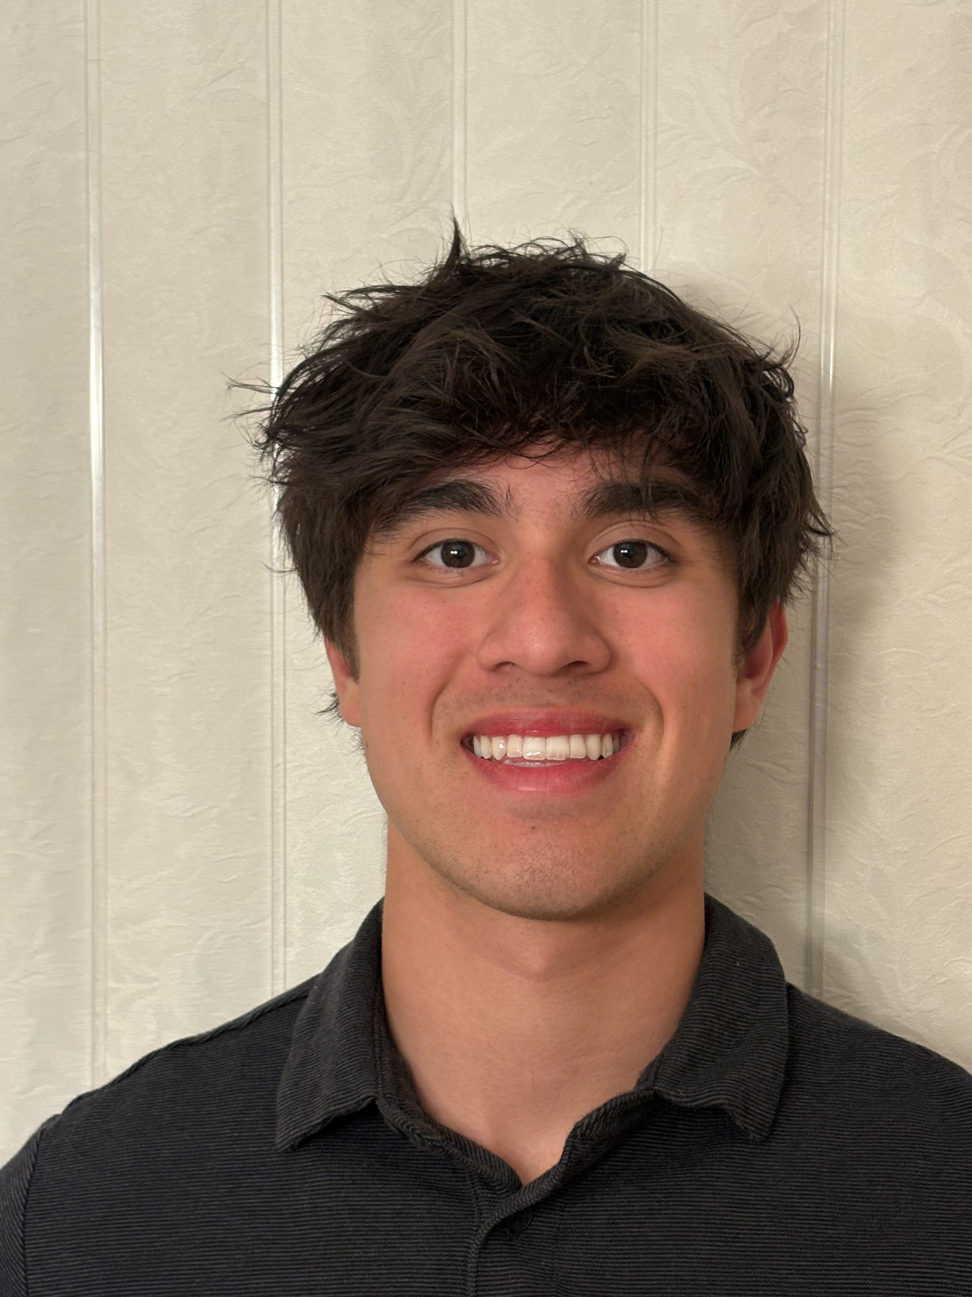
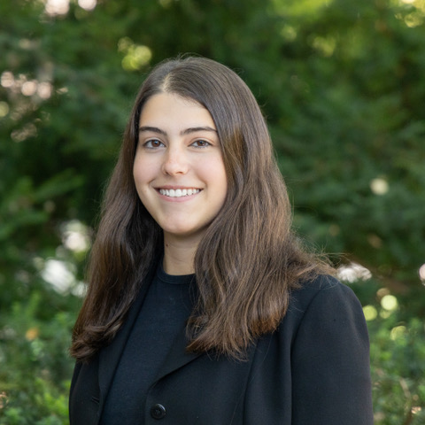
Scholarship Awardees • 11 of 40
Insert photo
Insert photo
Nikko Dunsmore
Emily Egna
Oregon State University
Penn State University

Slide 13
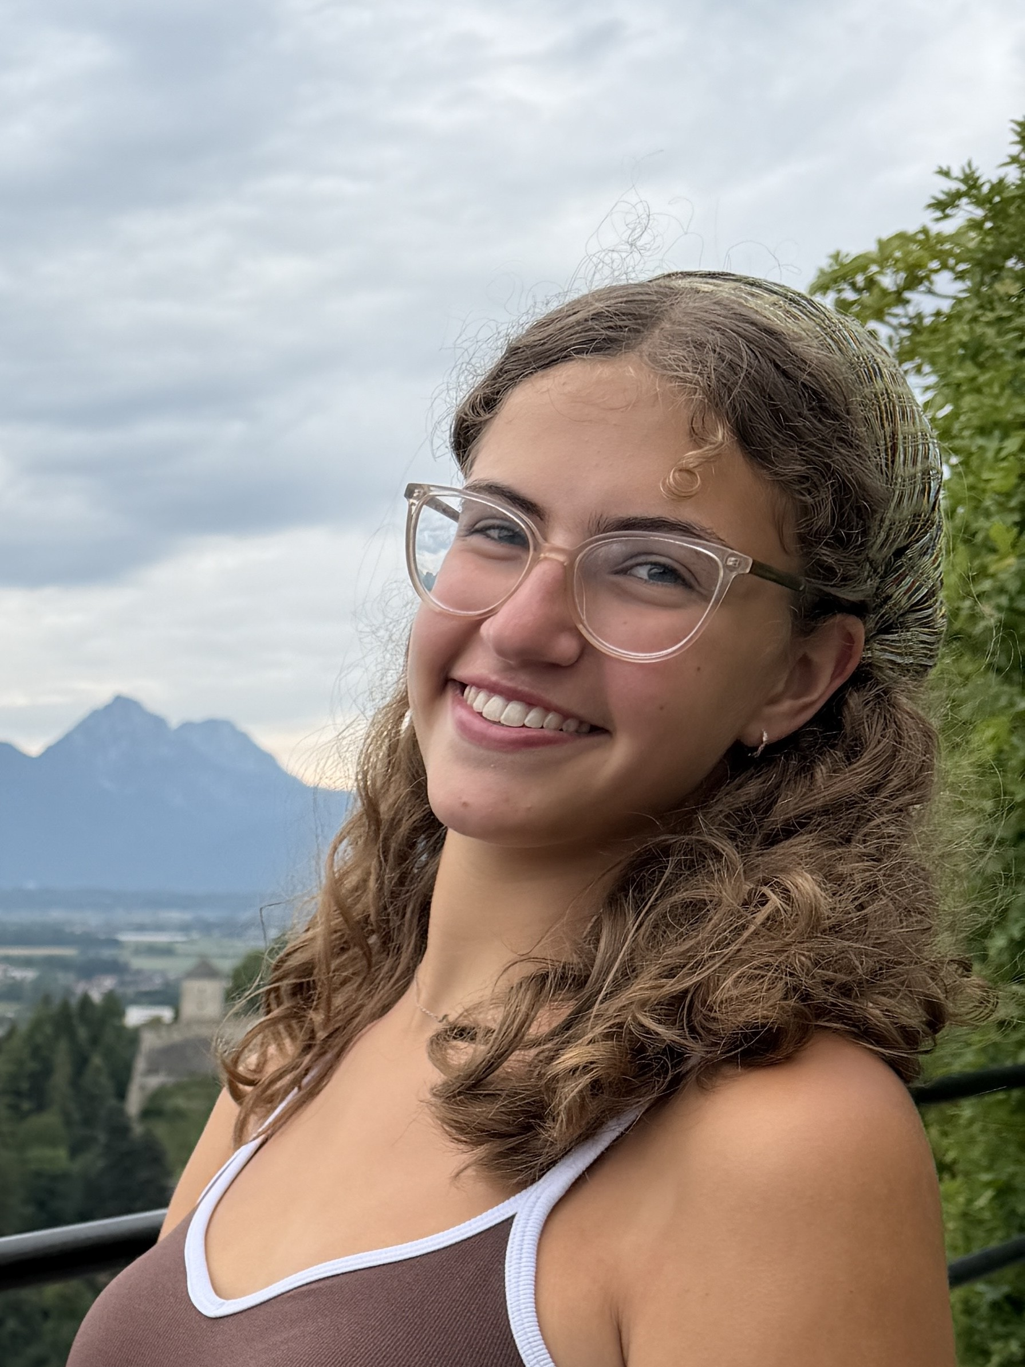
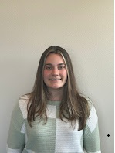
Scholarship Awardees • 12 of 40
Insert photo
Insert photo
Natalie Egna
Elizabeth Fabel
Penn State University
Point Loma Nazarene University

Slide 14
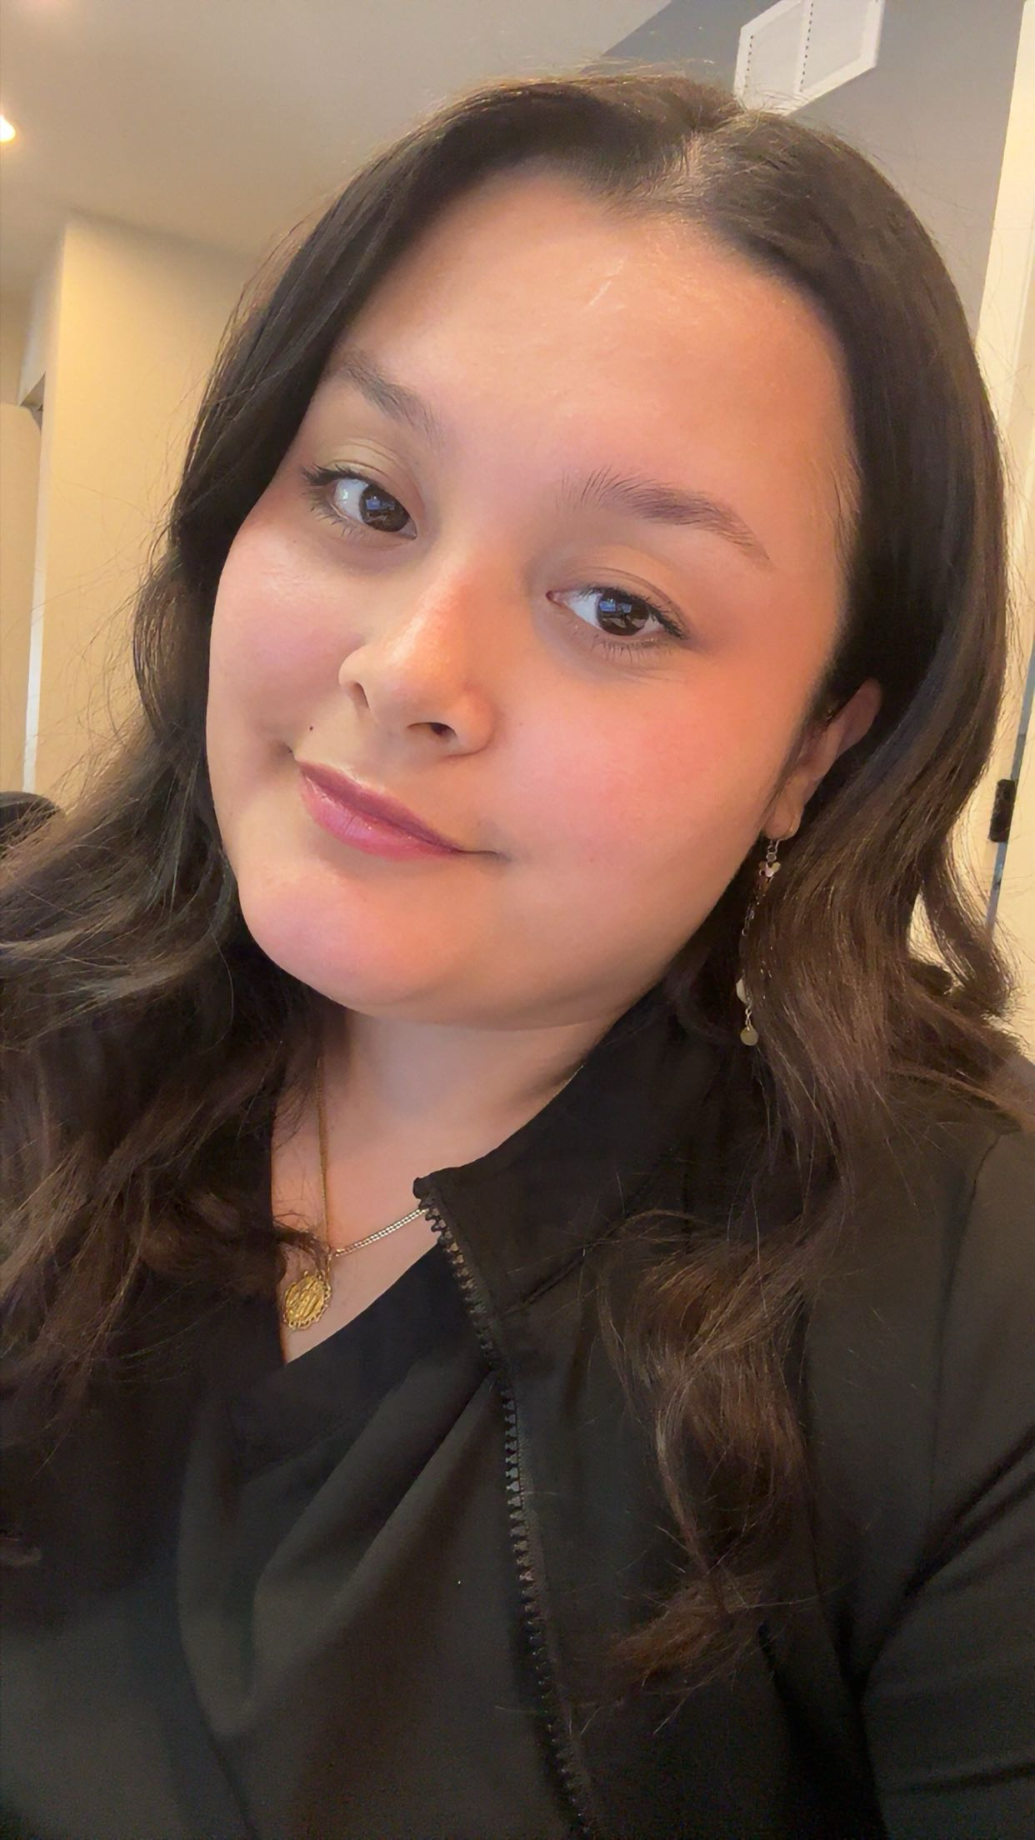
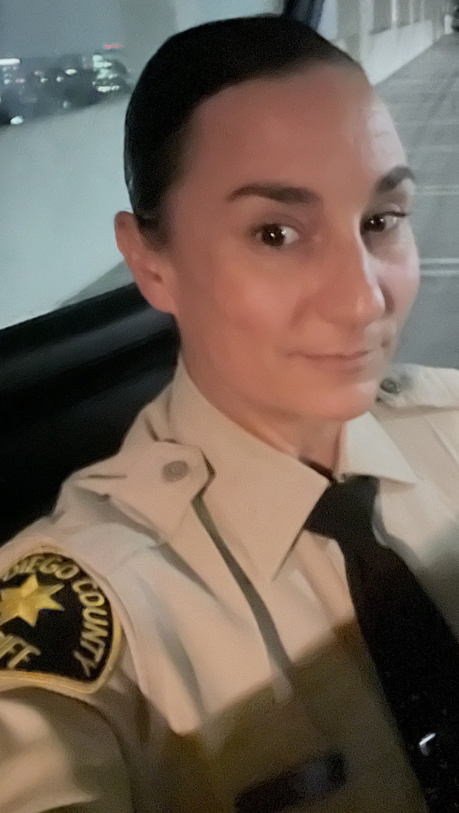
Scholarship Awardees • 13 of 40
Insert photo
Insert photo
Hannah Finks
Morgan Fomby
Joliet Junior College
University of San Diego

Slide 15
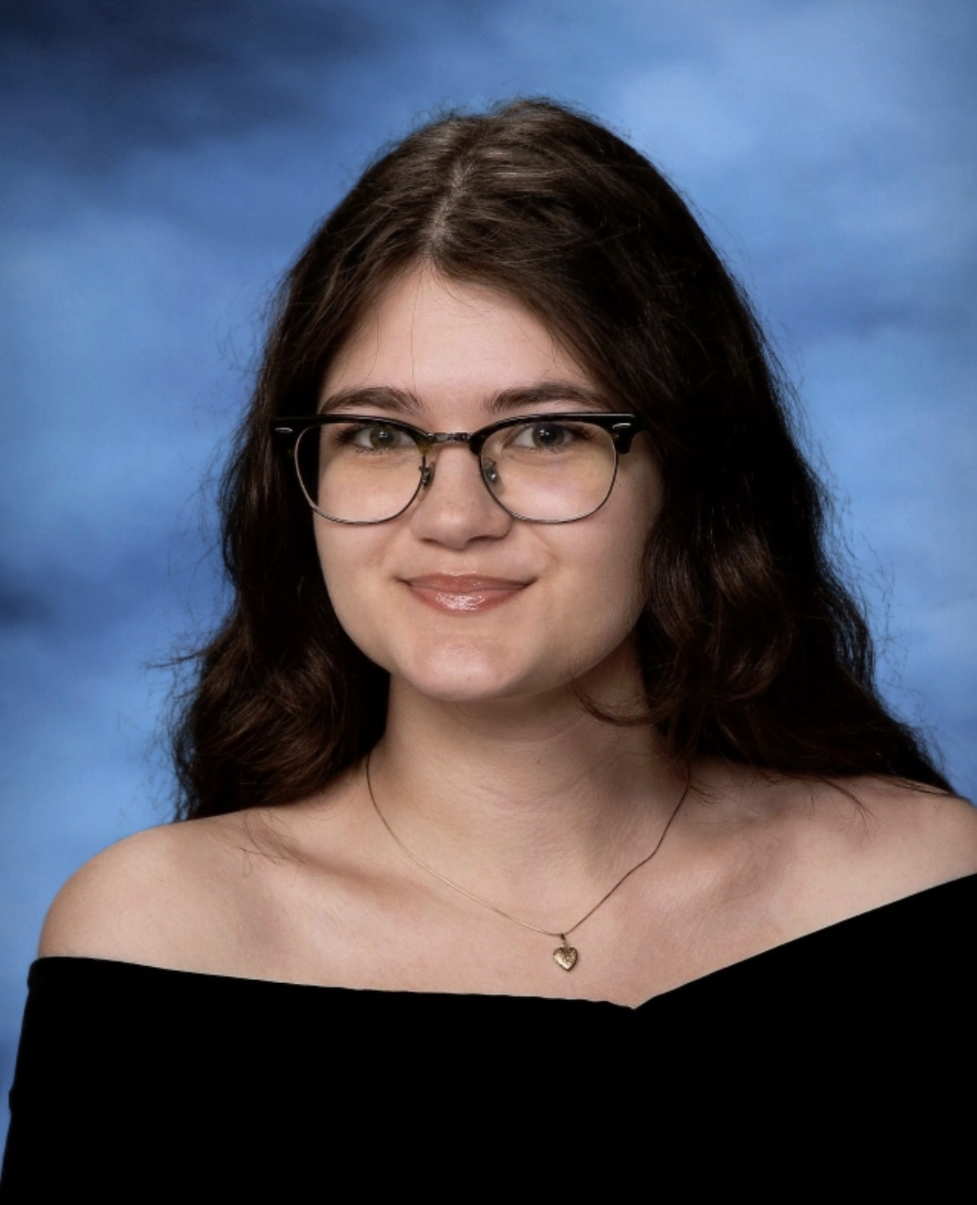
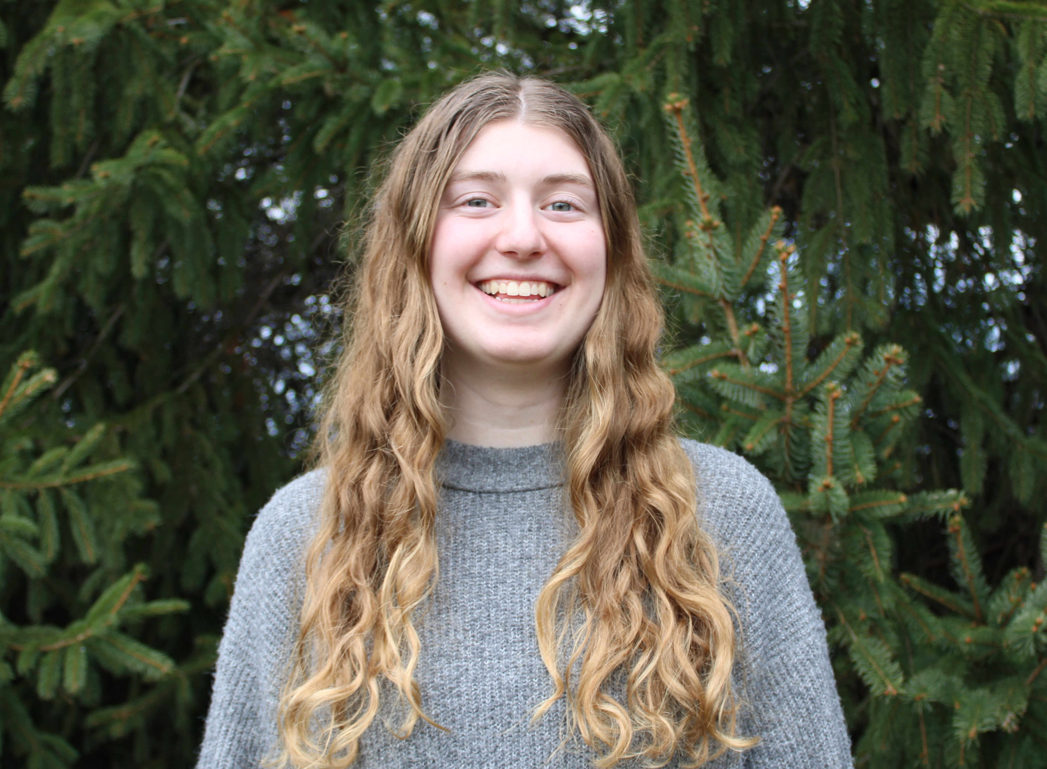
Scholarship Awardees • 14 of 40
Insert photo
Insert photo
Leah Forry
Samantha Garner
Grove City College
UNC-Chapel Hill

Slide 16
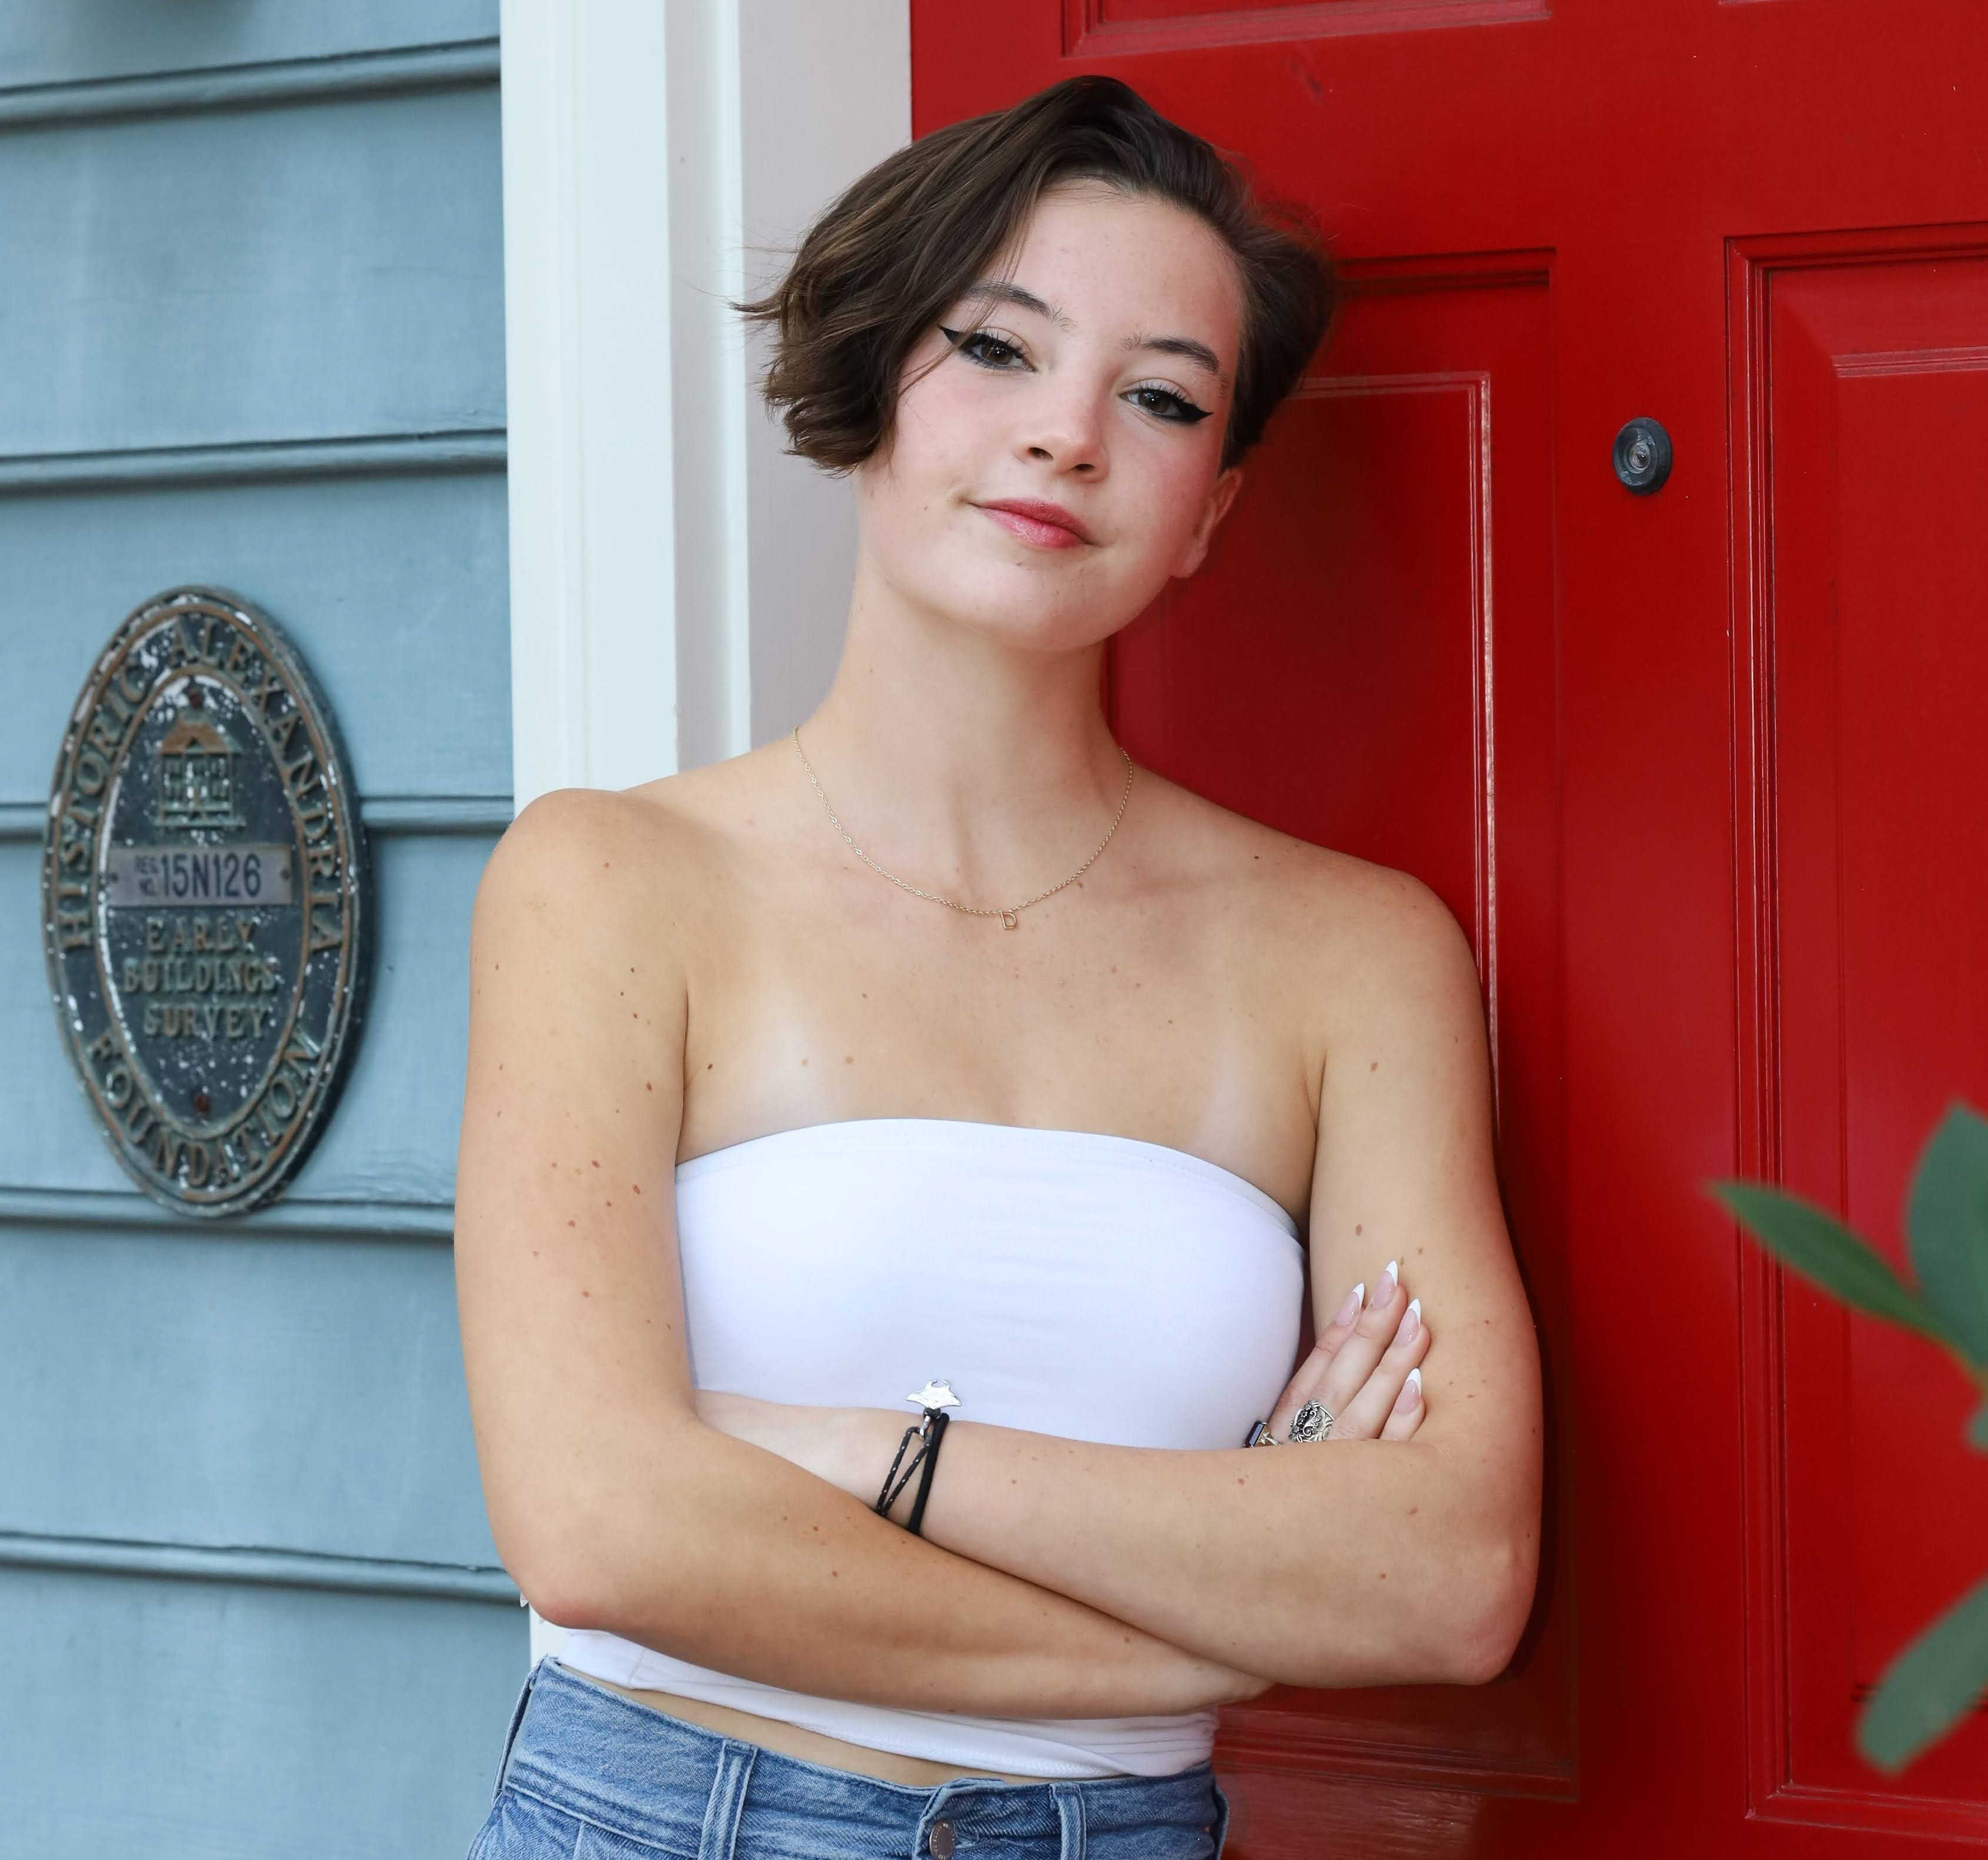
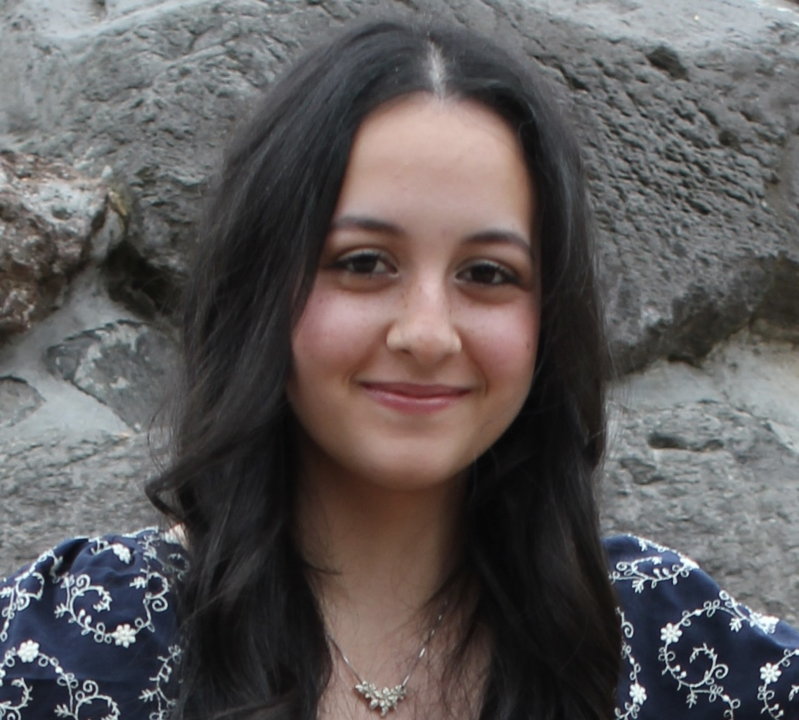
Scholarship Awardees • 15 of 40
Insert photo
Insert photo
Colleen Gilbert
Mercedes Gonzalez
University of New England
Grand Canyon University

Slide 17
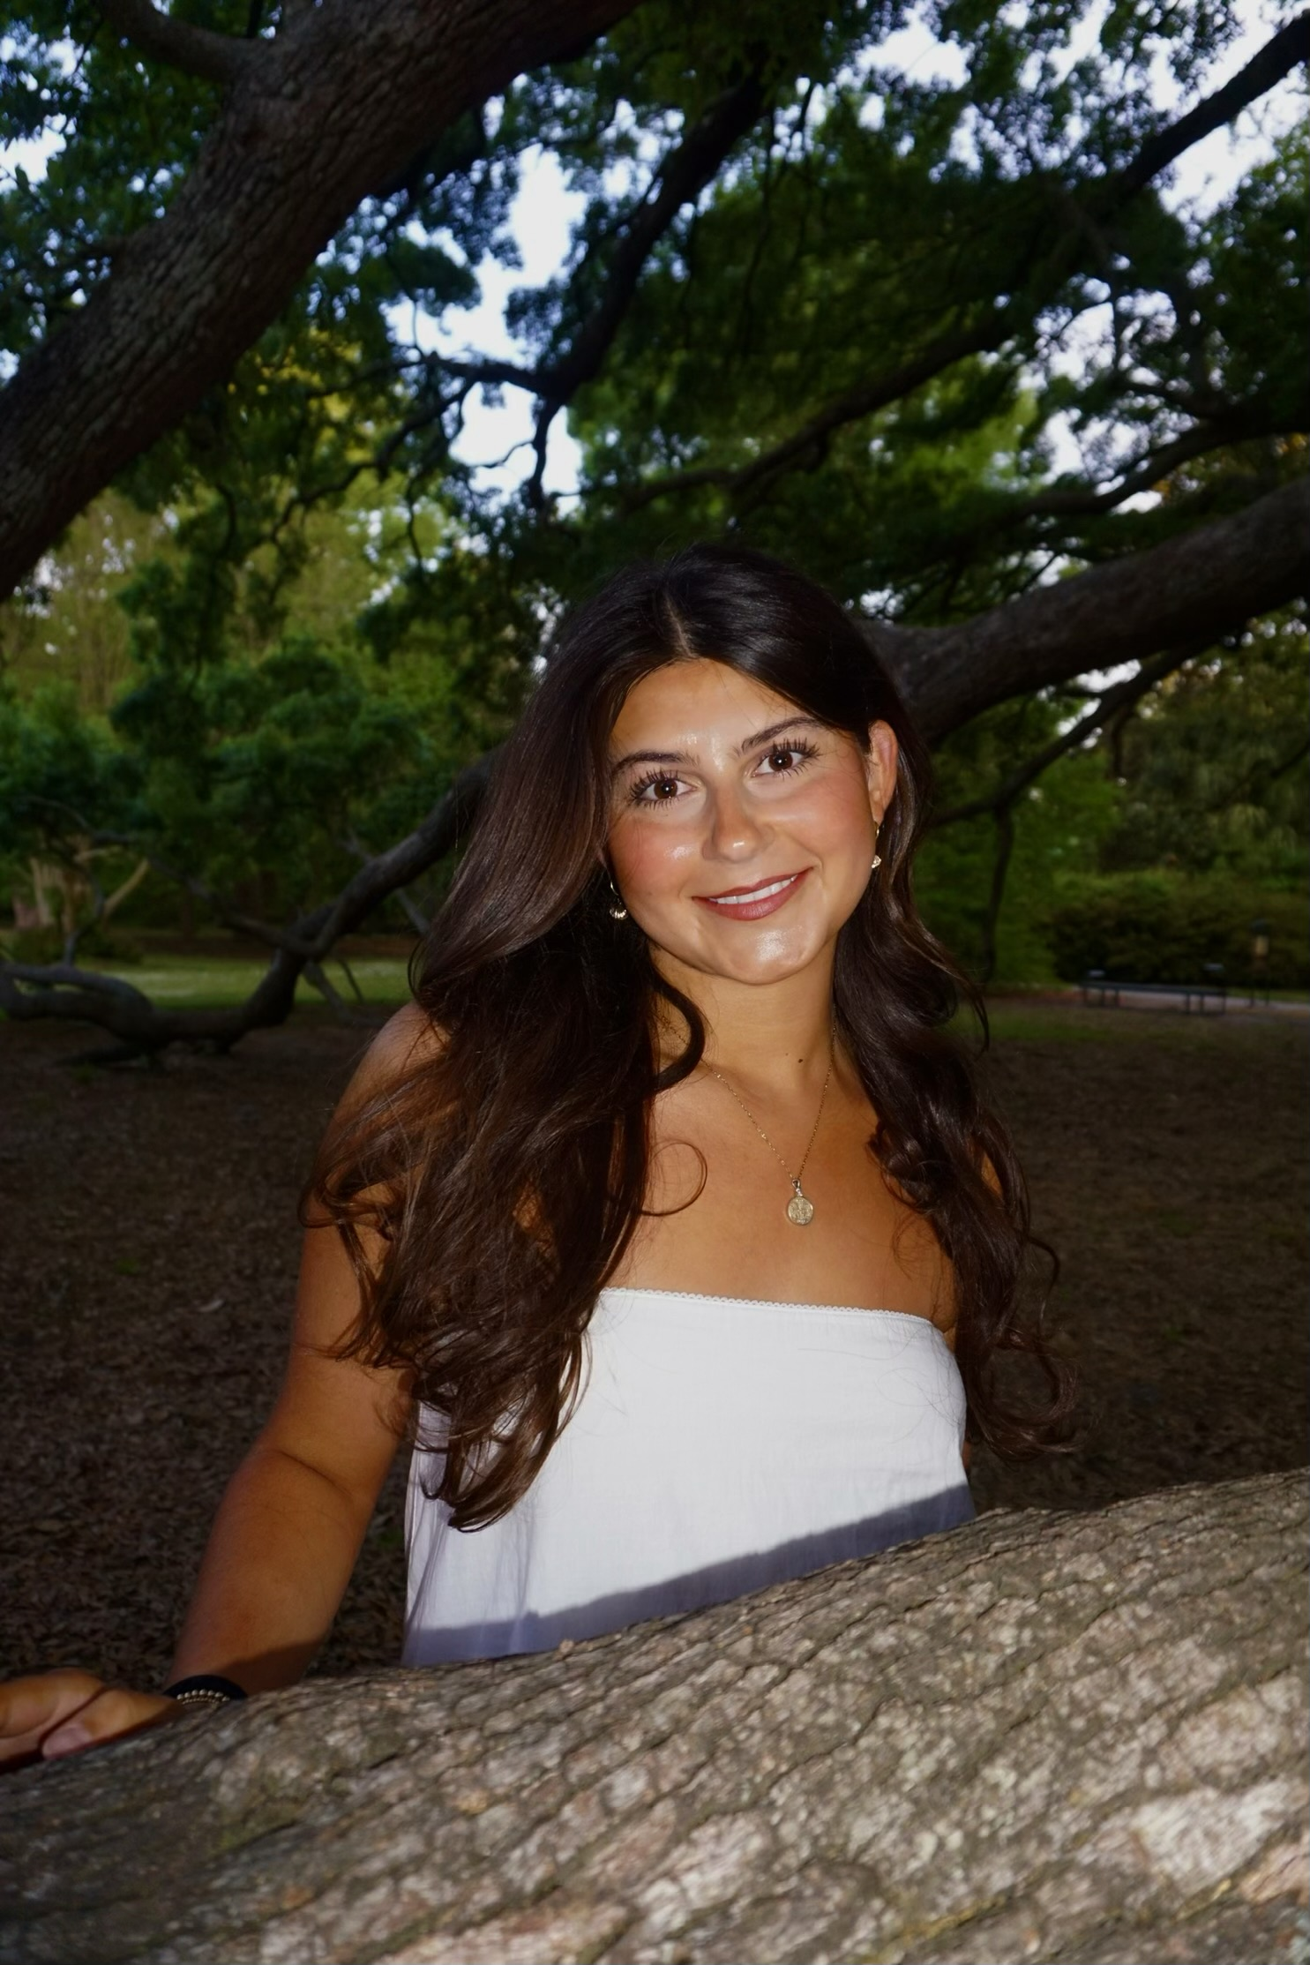
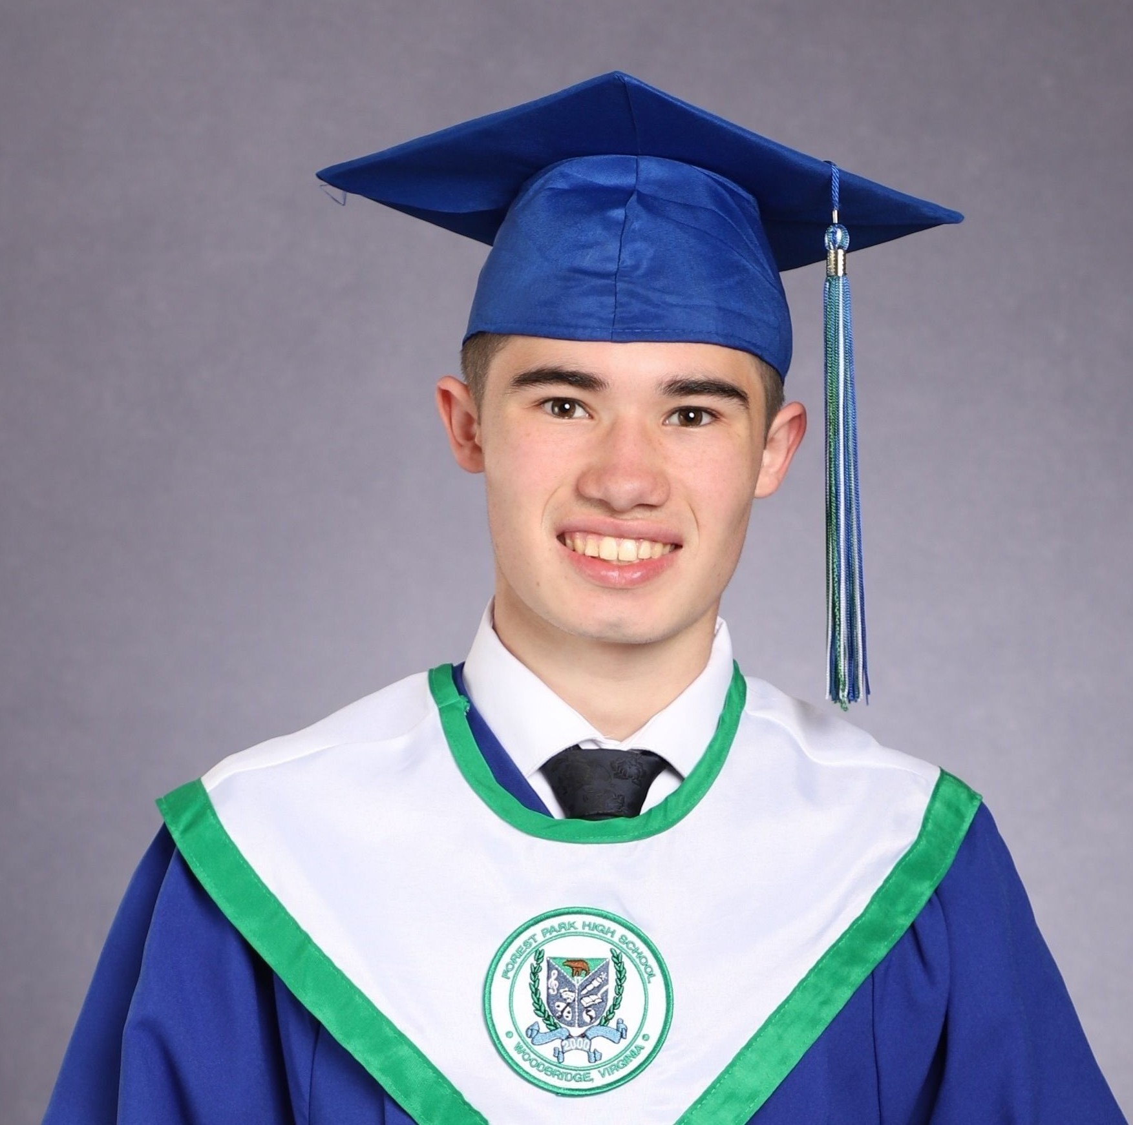
Scholarship Awardees • 16 of 40
Insert photo
Insert photo
Tristan Hernandez
Sophia Hoffmann
James Madison University
Anderson University

Slide 18
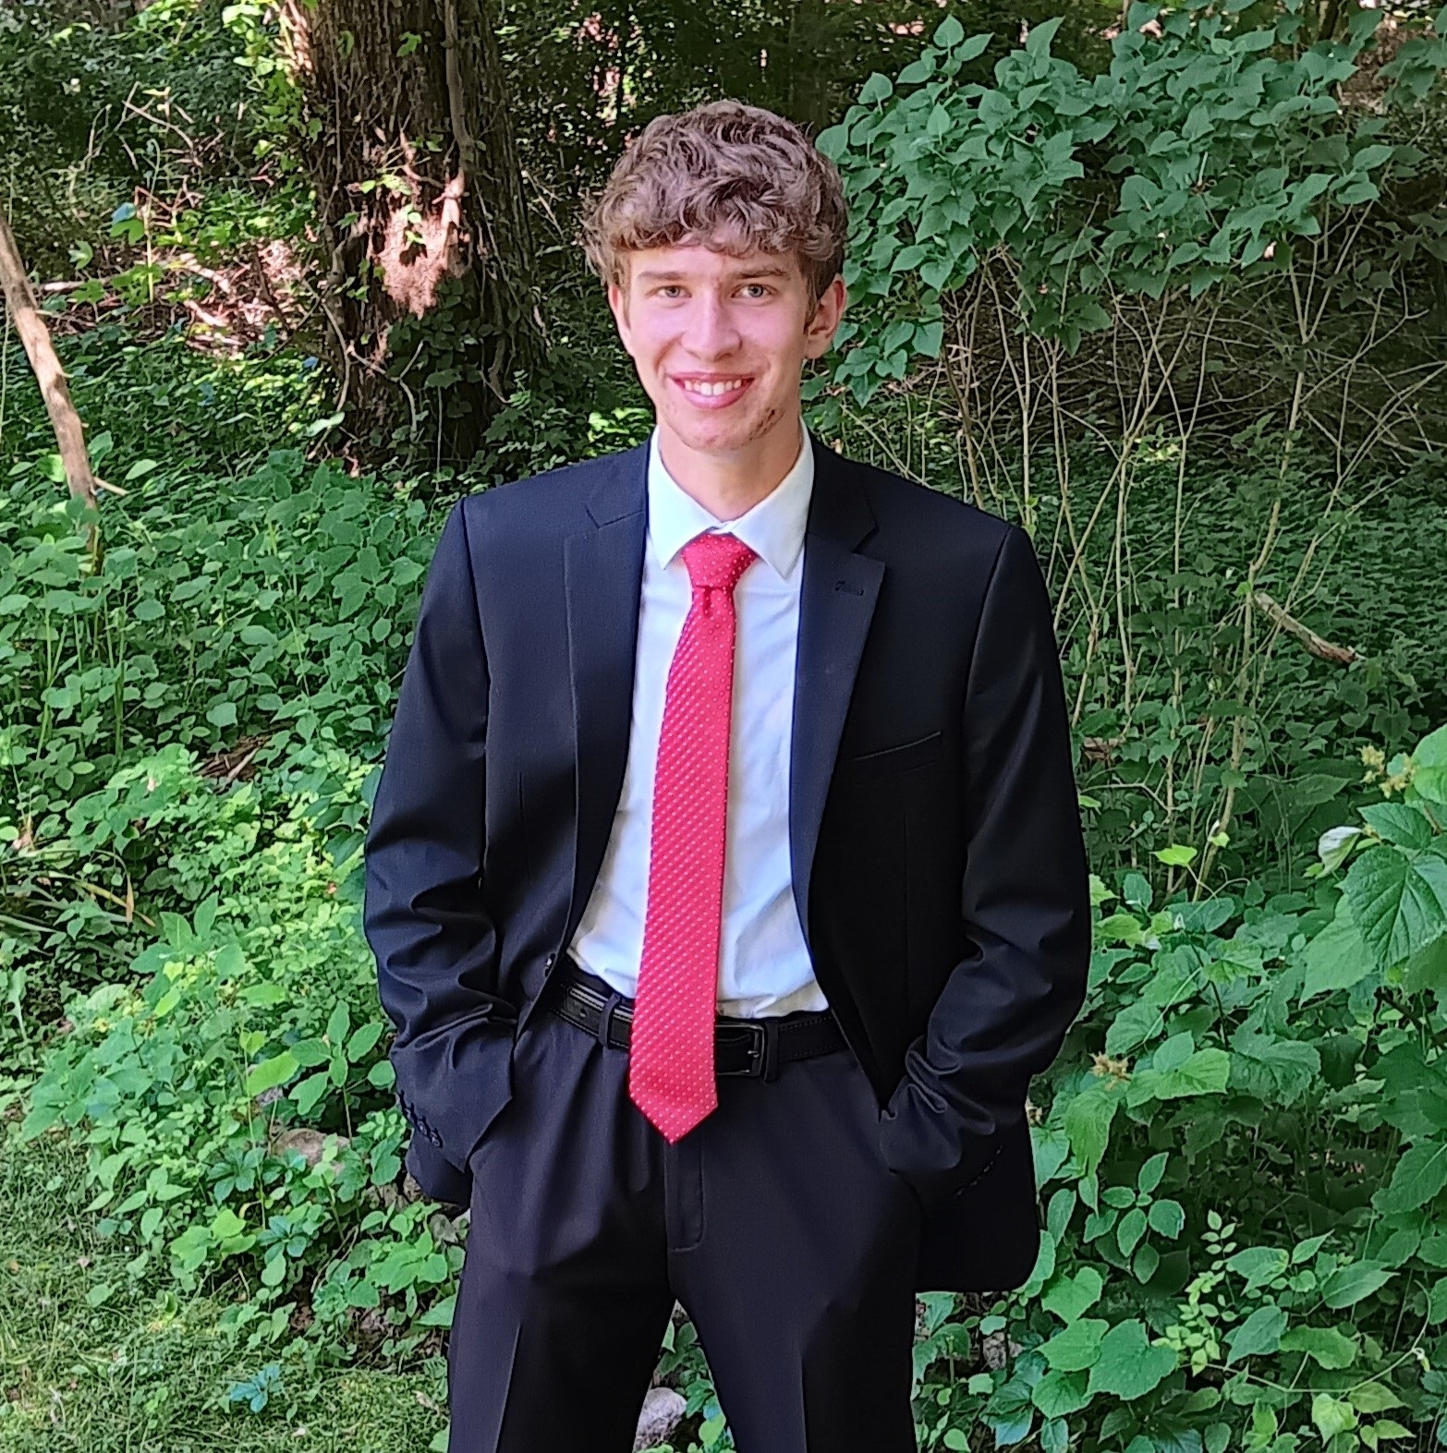
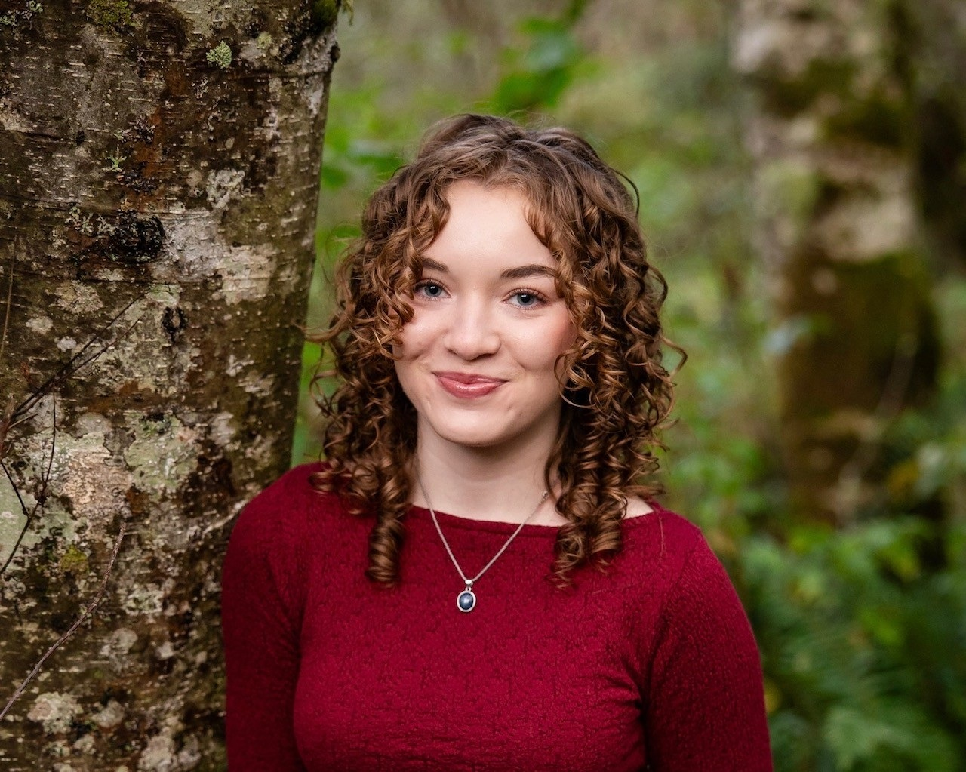
Scholarship Awardees • 17 of 40
Insert photo
Insert photo
Gabe Huff
Bella Johnston
Roger Williams University
Oregon State University

Slide 19
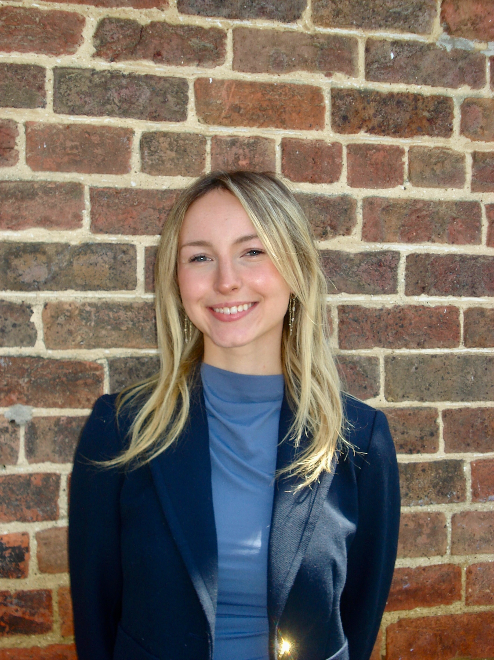
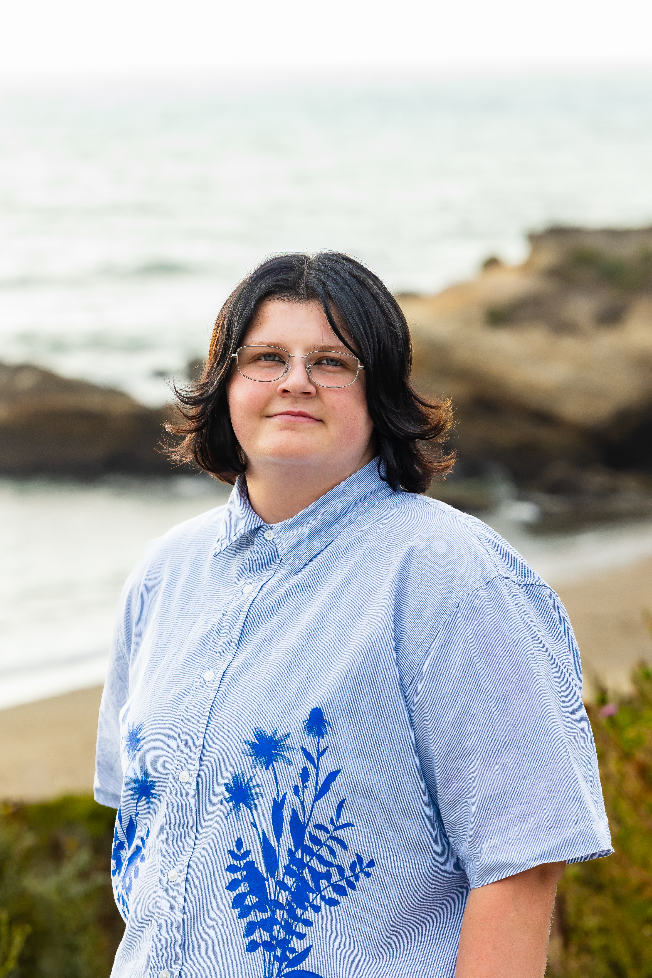
Scholarship Awardees • 18 of 40
Insert photo
Insert photo
Maresa Kanekkeberg
Charlotte Klopfer
Virginia Tech
Montana State University

Slide 20
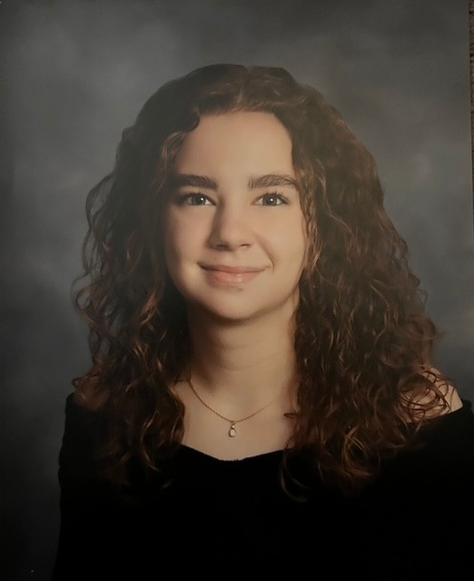
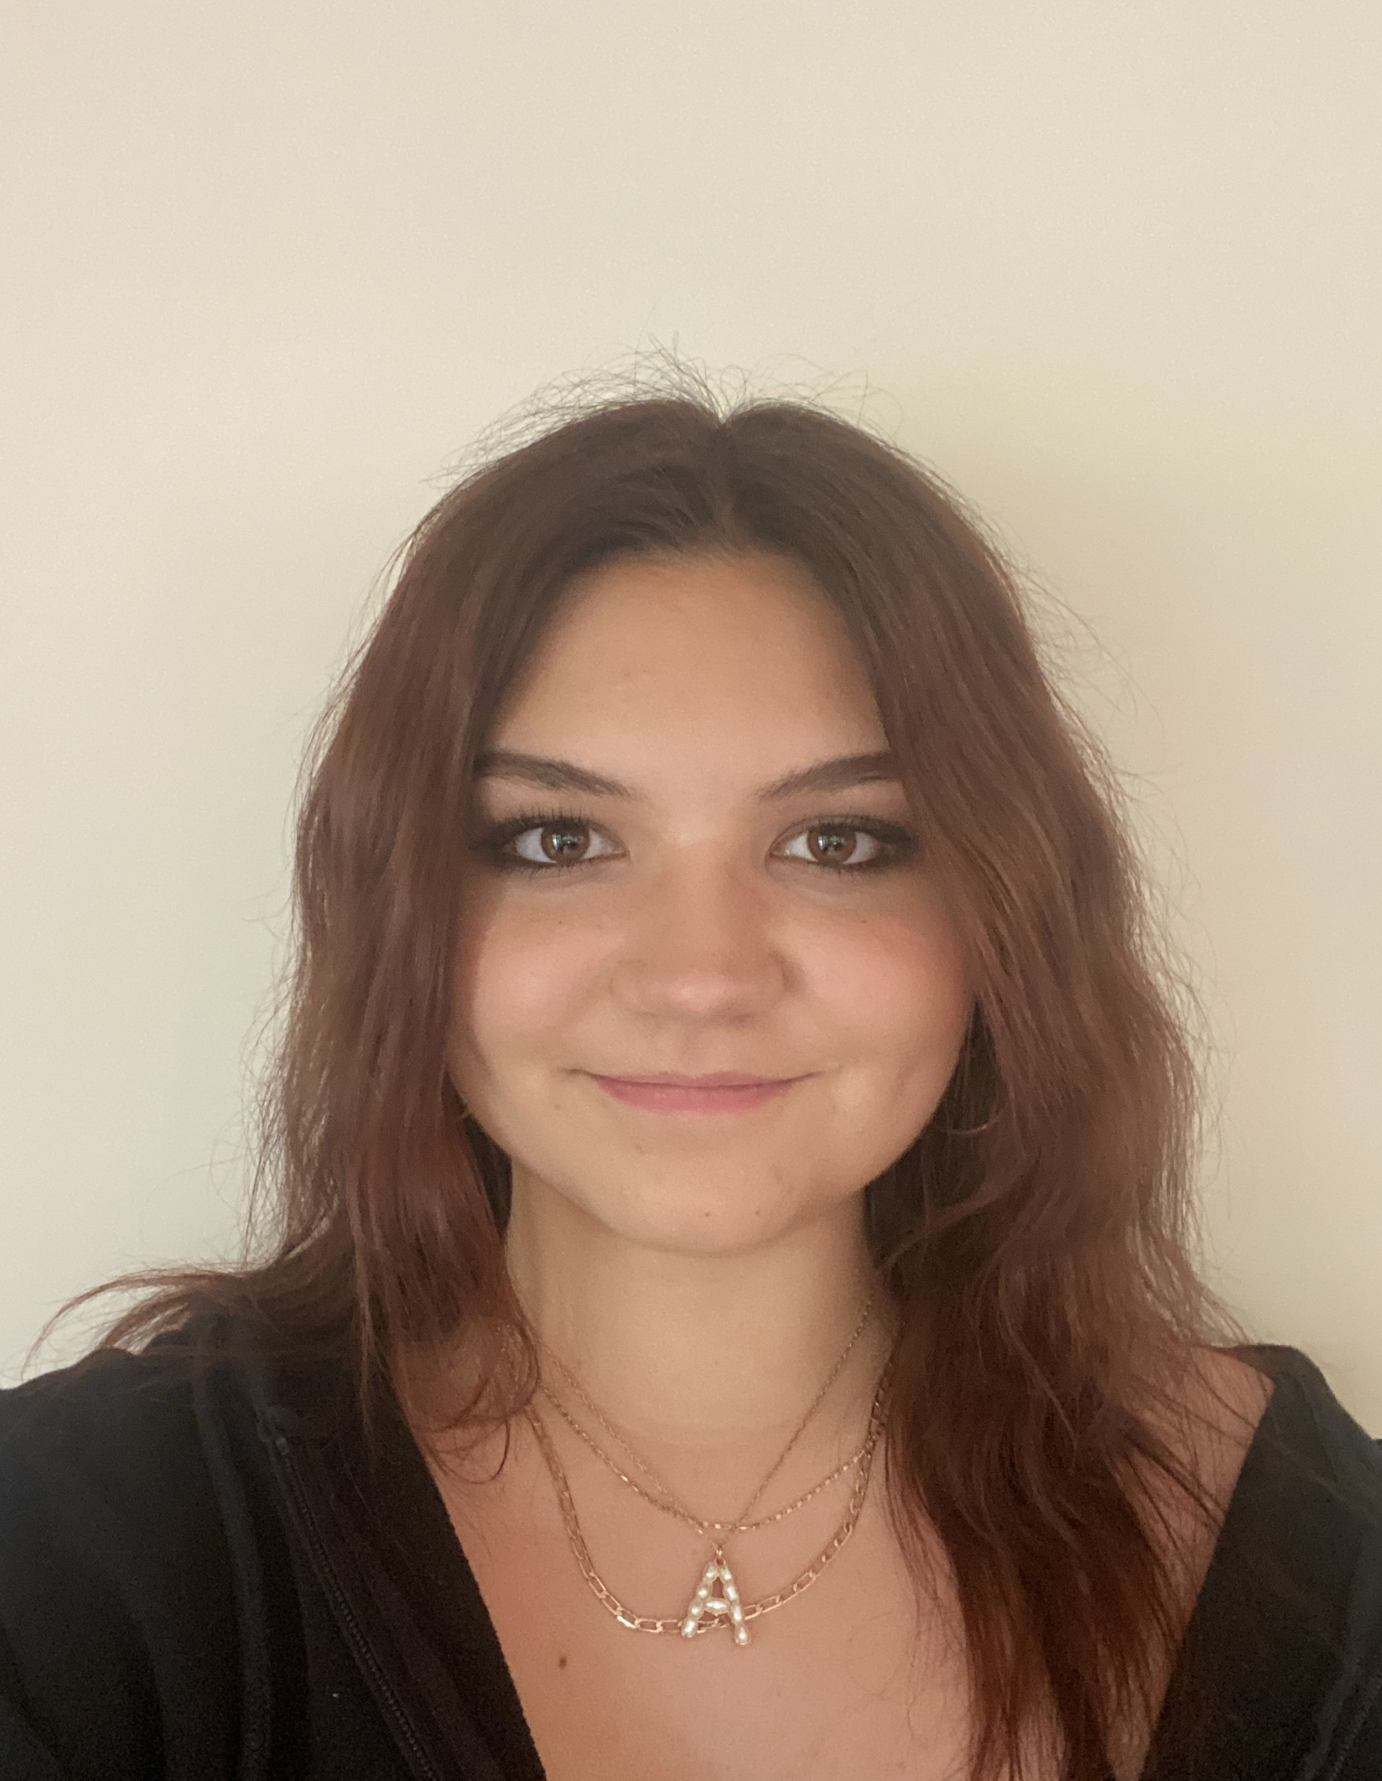
Scholarship Awardees • 19 of 40
Insert photo
Insert photo
Emily Koplin
Ava LaPenna
Bucknell University
Rochester Institute of Technology

Slide 21
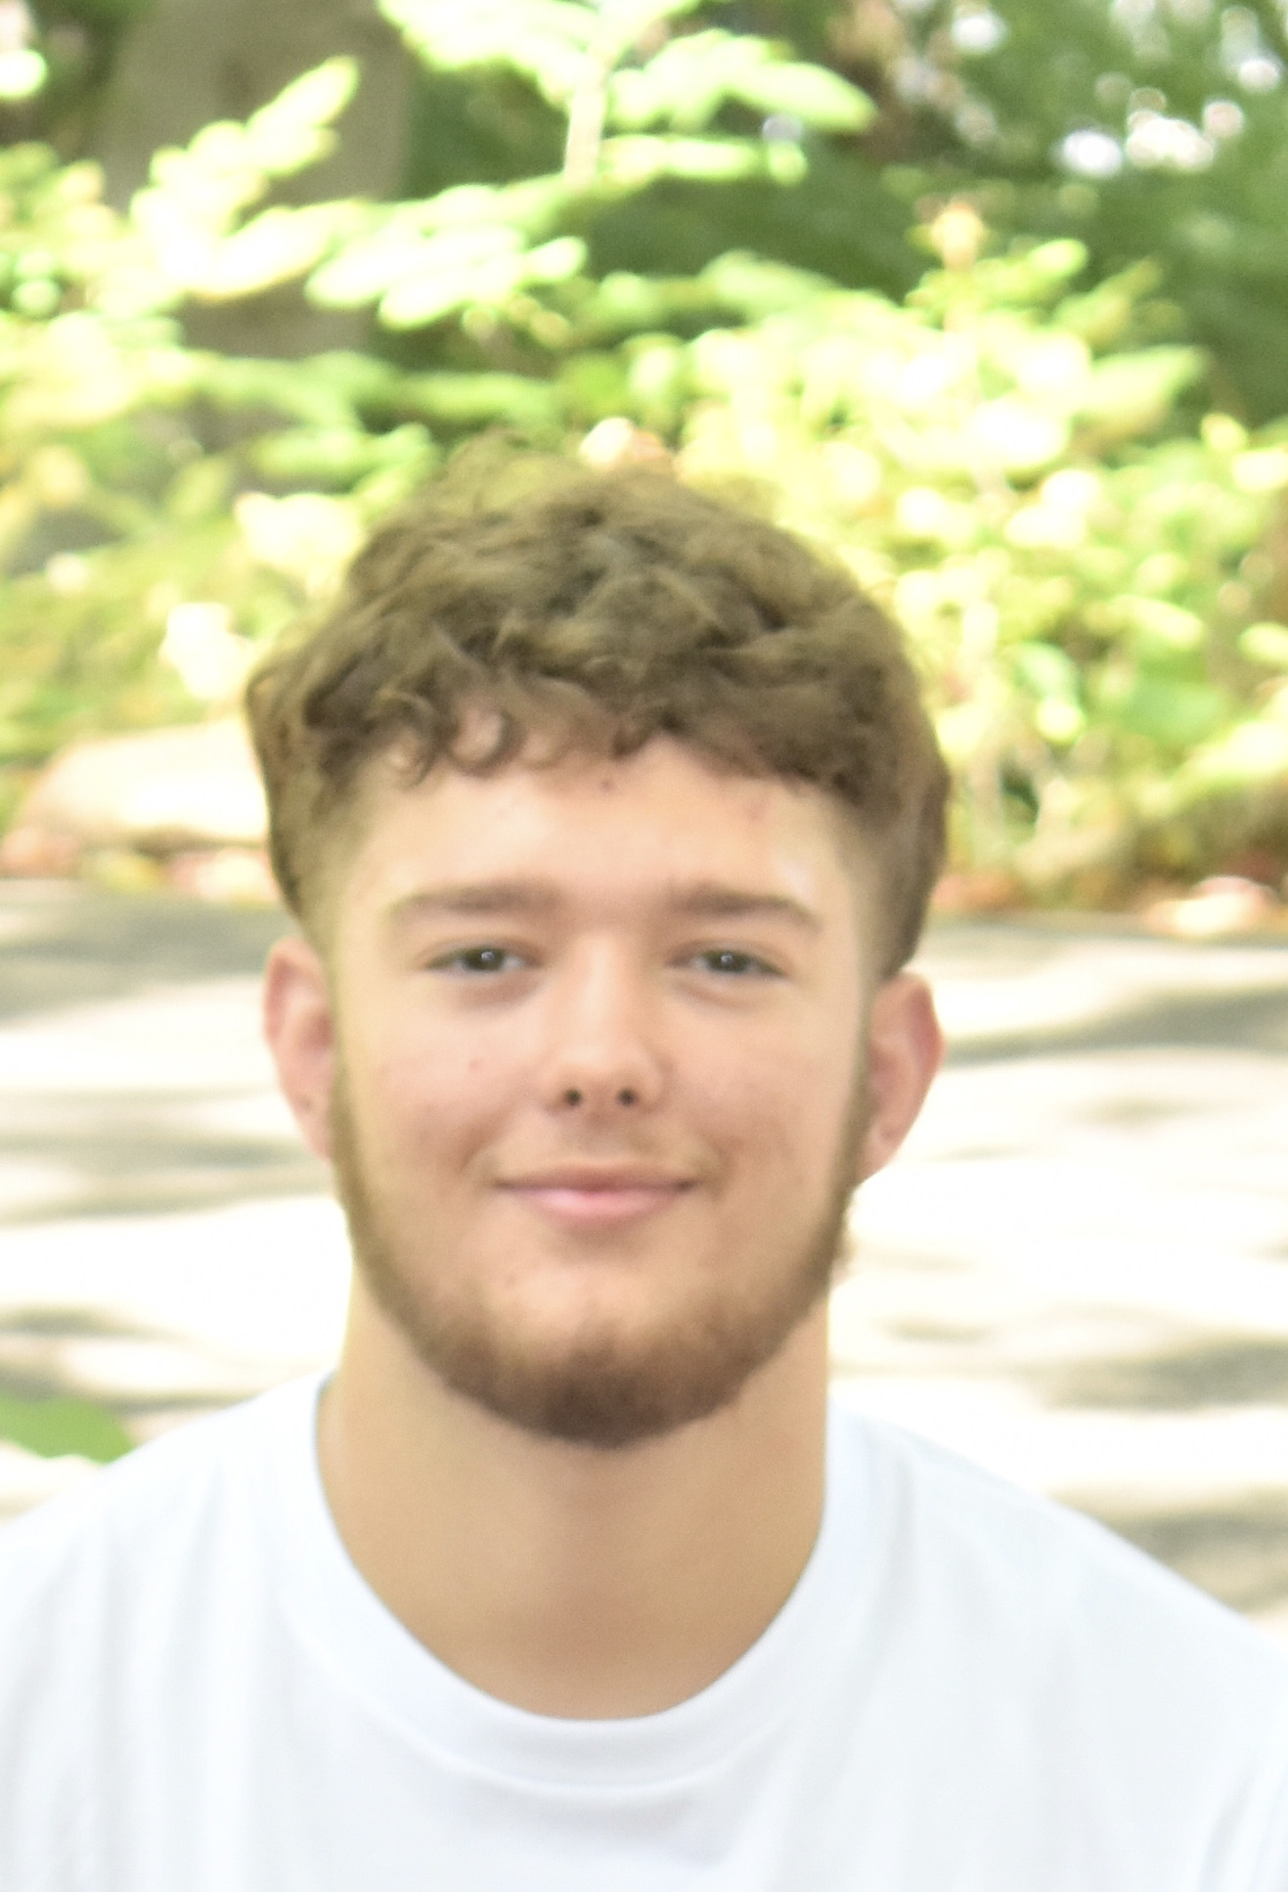
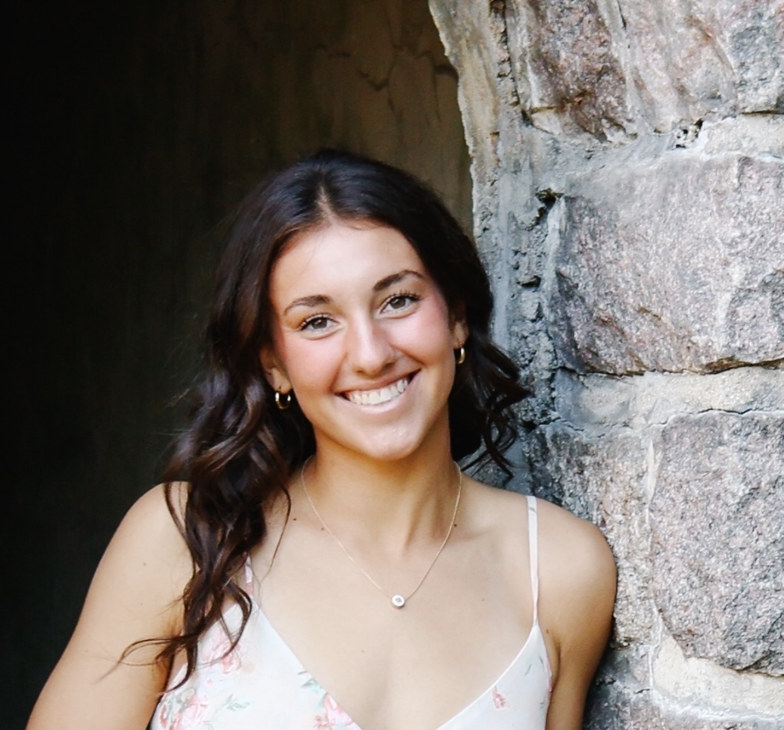
Scholarship Awardees • 20 of 40
Insert photo
Insert photo
Natalie Lentine
Lewis Mains
Morehead State University
Robert Morris University

Slide 22
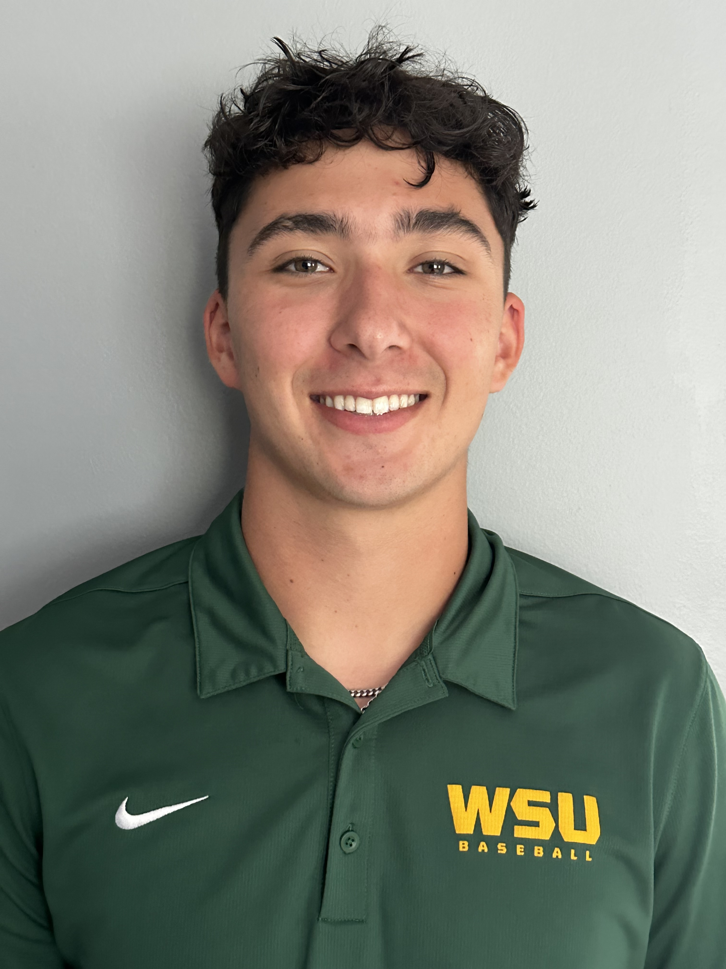
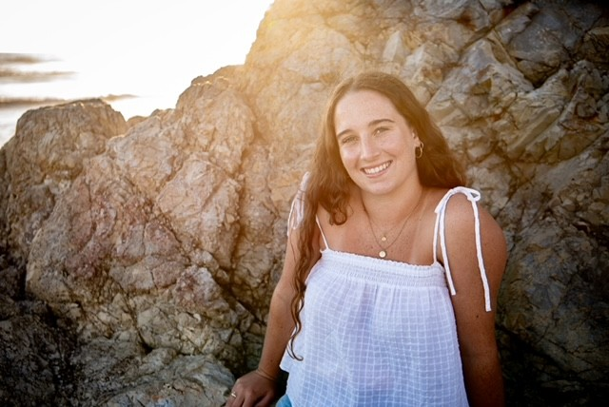
Scholarship Awardees • 21 of 40
Insert photo
Insert photo
Matt Mareno
Mary Marsalek
Wayne State University
Boston College

Slide 23
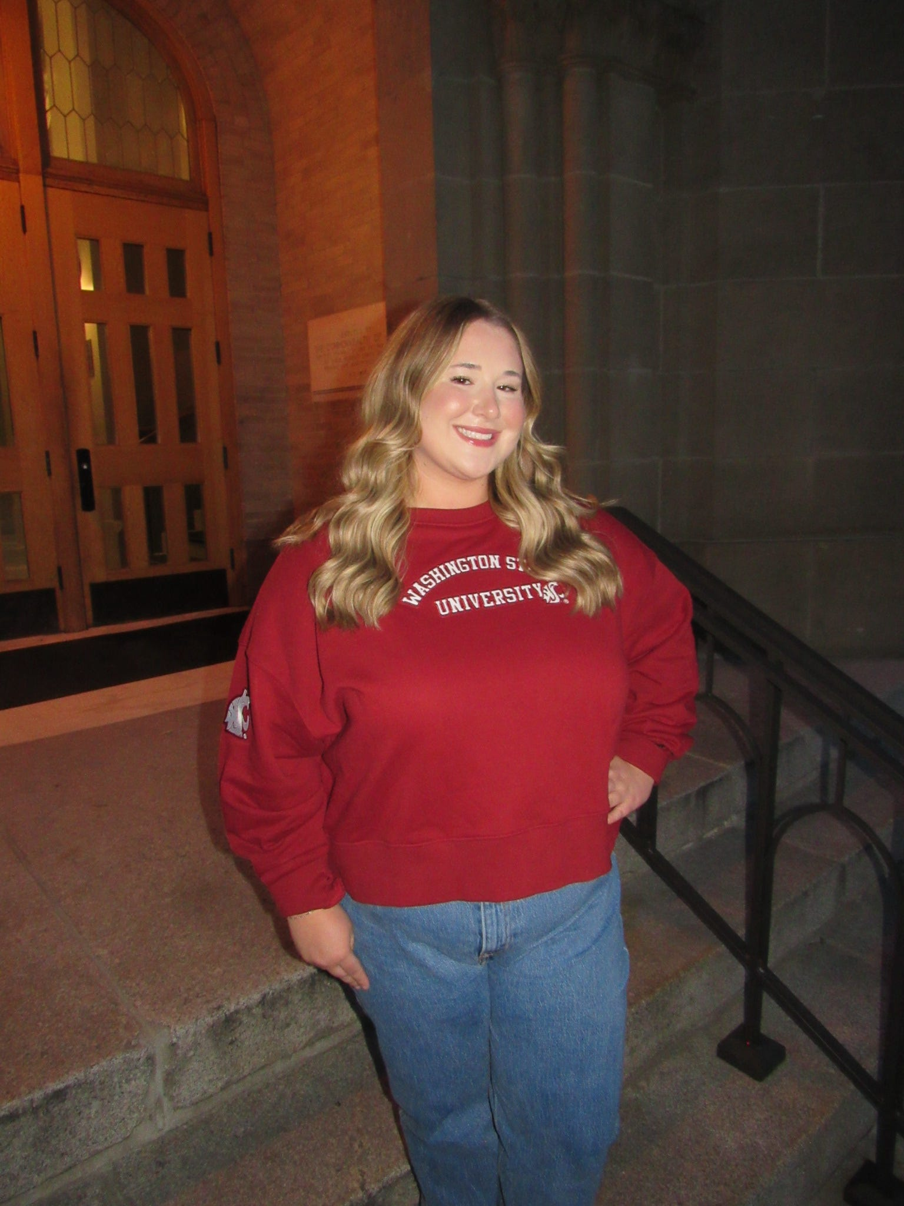
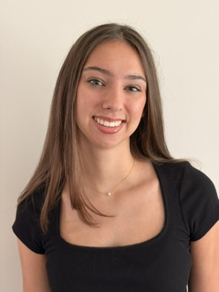
Scholarship Awardees • 22 of 40
Insert photo
Insert photo
Ashtyn Martin
Sophia Martin
Washington State University
Michigan State University

Slide 24
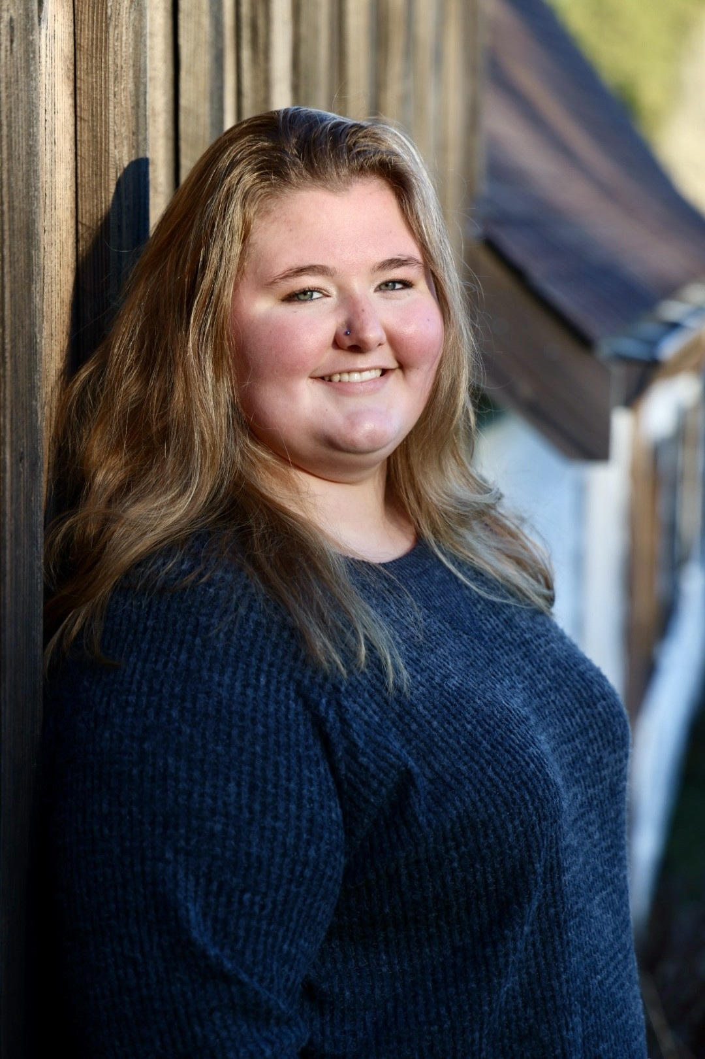
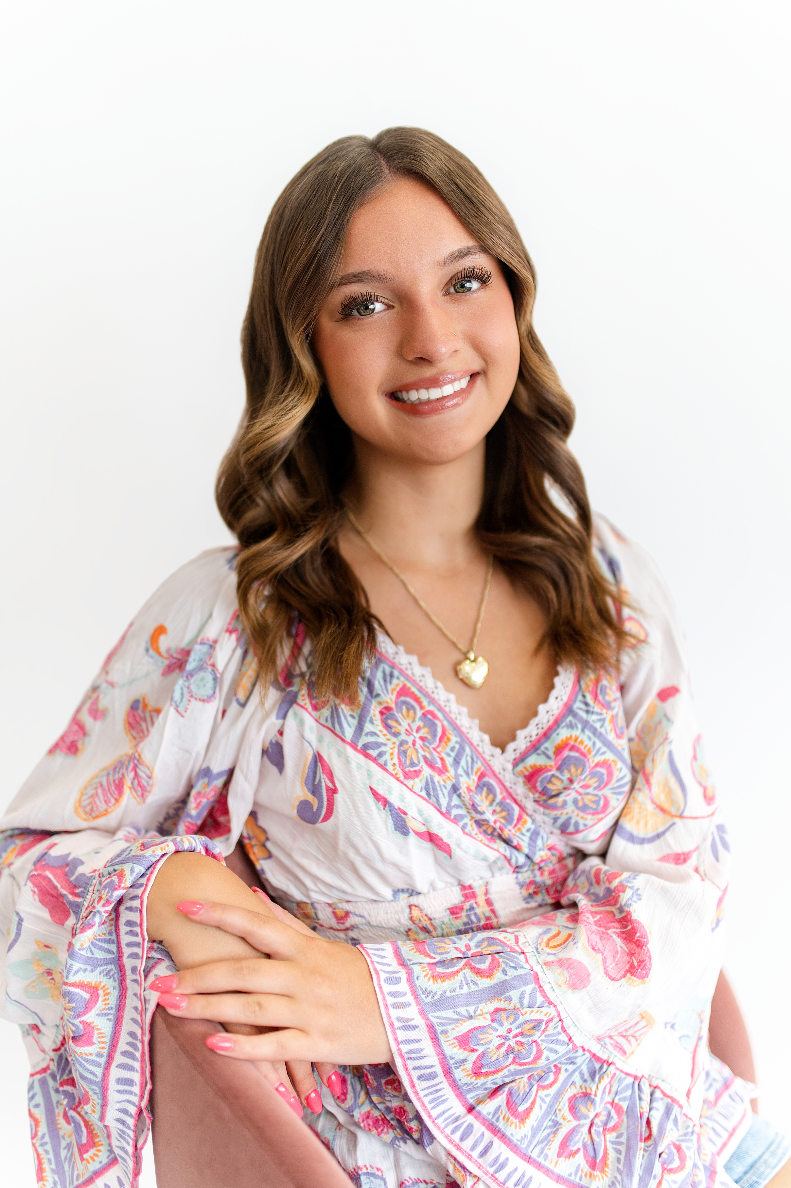
Scholarship Awardees • 23 of 40
Insert photo
Insert photo
Hadleigh Martin
Brooke Masoner
Arizona State University
Auburn University

Slide 25

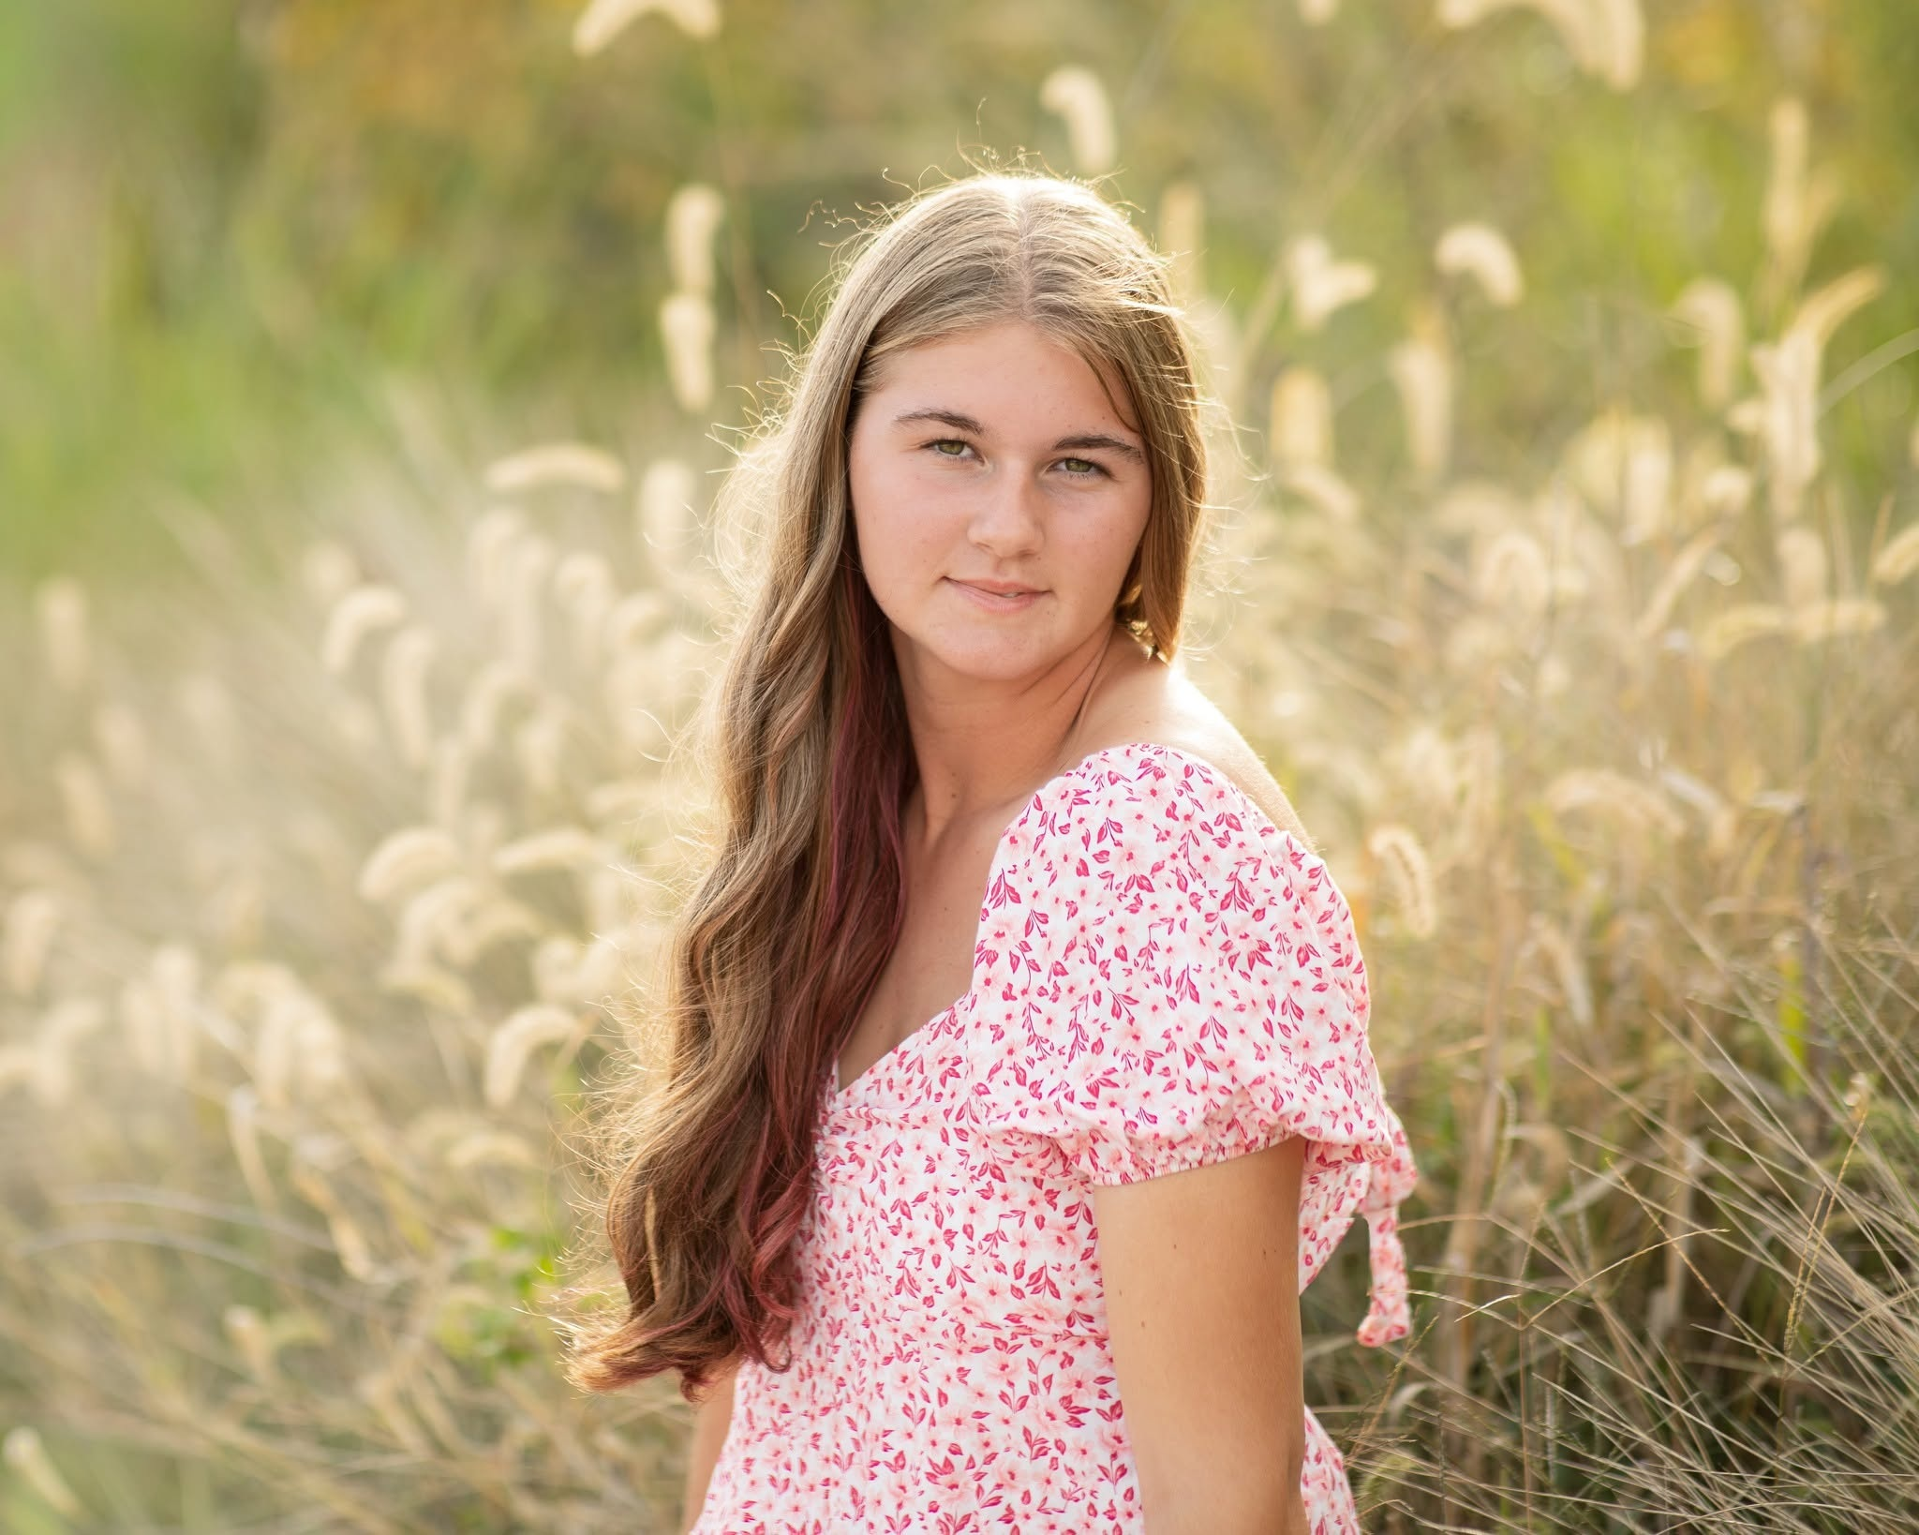
Scholarship Awardees • 24 of 40
Insert photo
Insert photo
Grace Mellen
Cecilia Mendez
Charleston Southern University
Appalachian State University

Slide 26

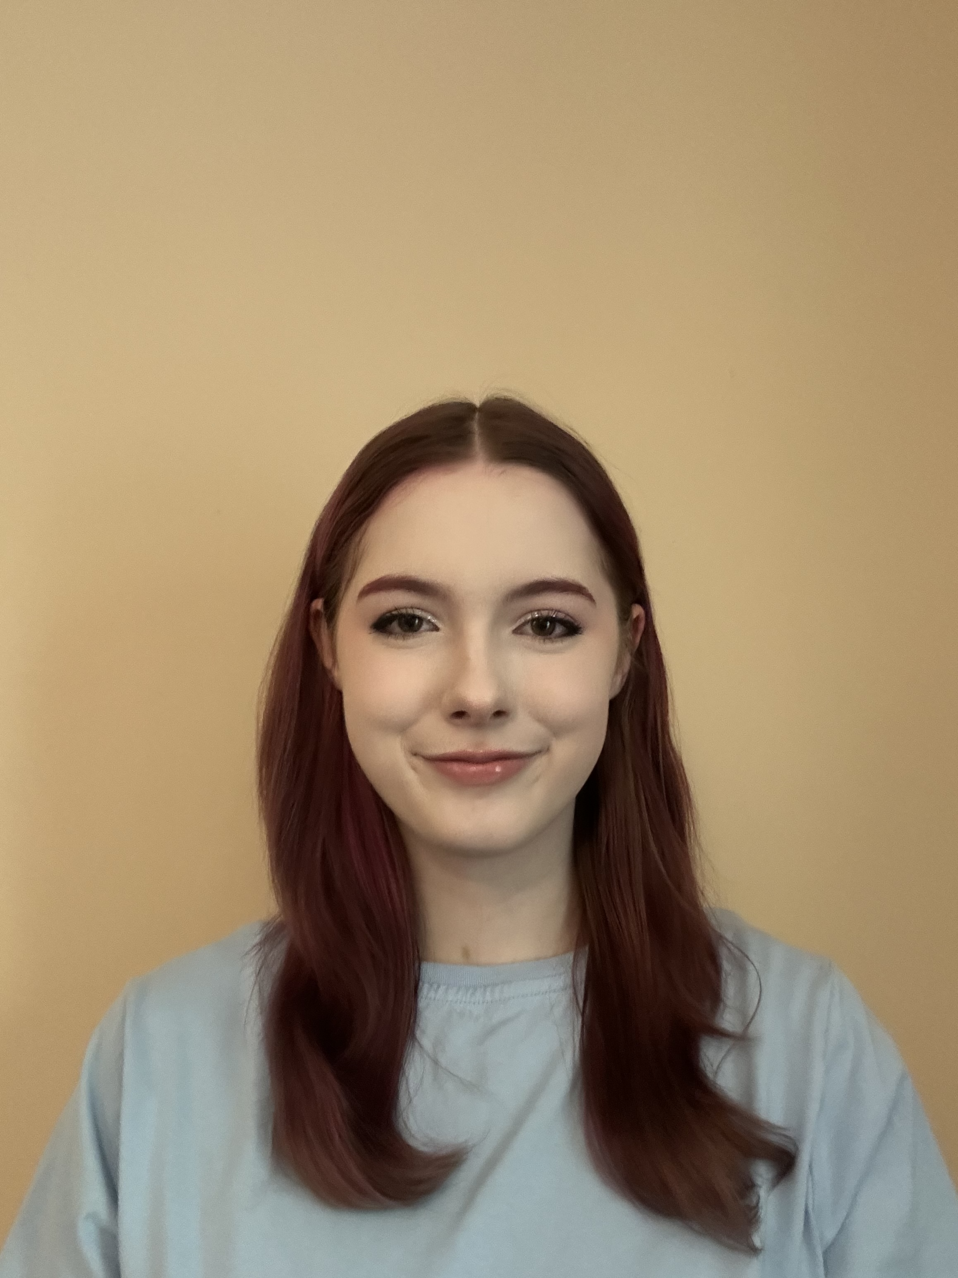
Scholarship Awardees • 25 of 40
Insert photo
Insert photo
Owen Mendez
Olivia Merrill
NC State University
UNC-Asheville

Slide 27
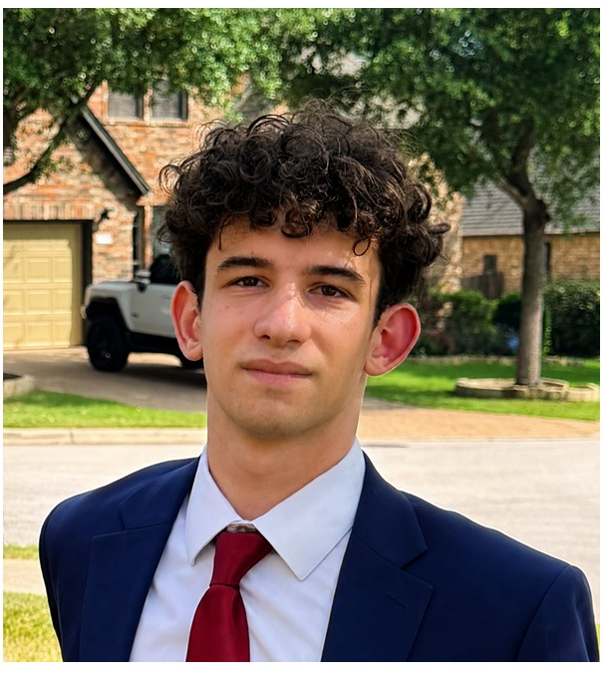
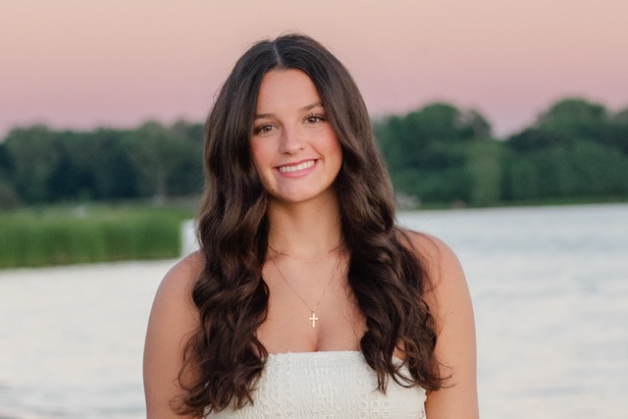
Scholarship Awardees • 26 of 40
Insert photo
Insert photo
Jordan Messing
Julia Midbo
Indiana University-Bloomington
Central Michigan University

Slide 28
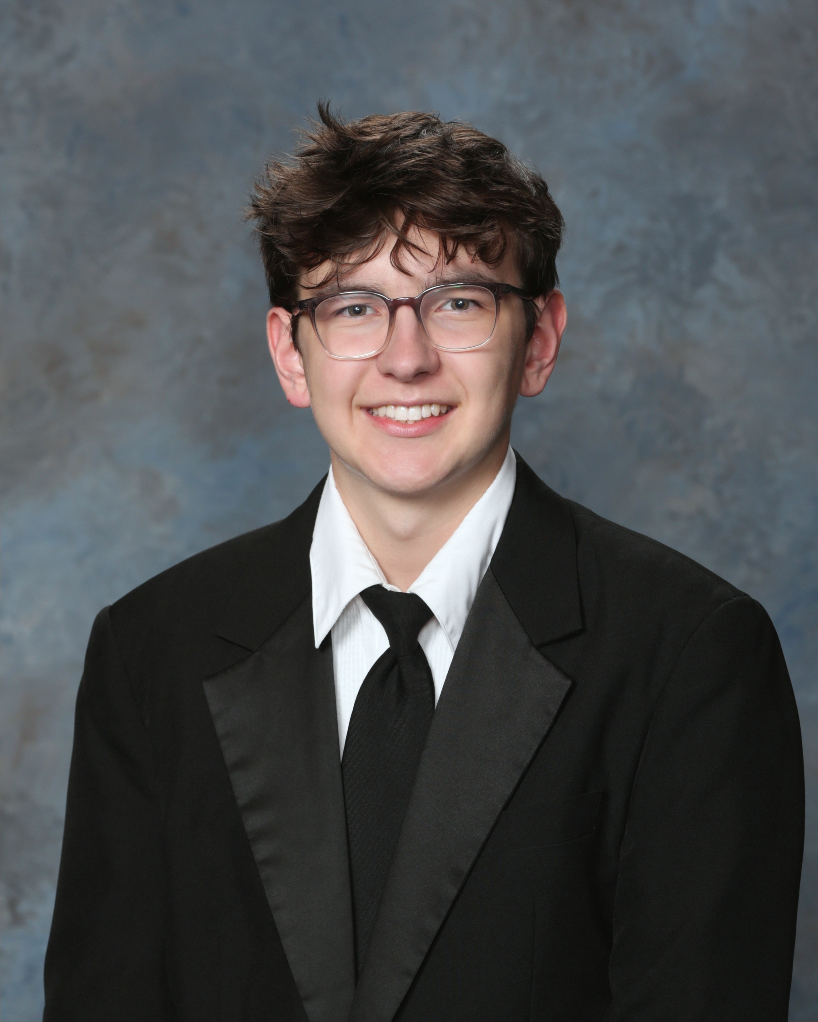
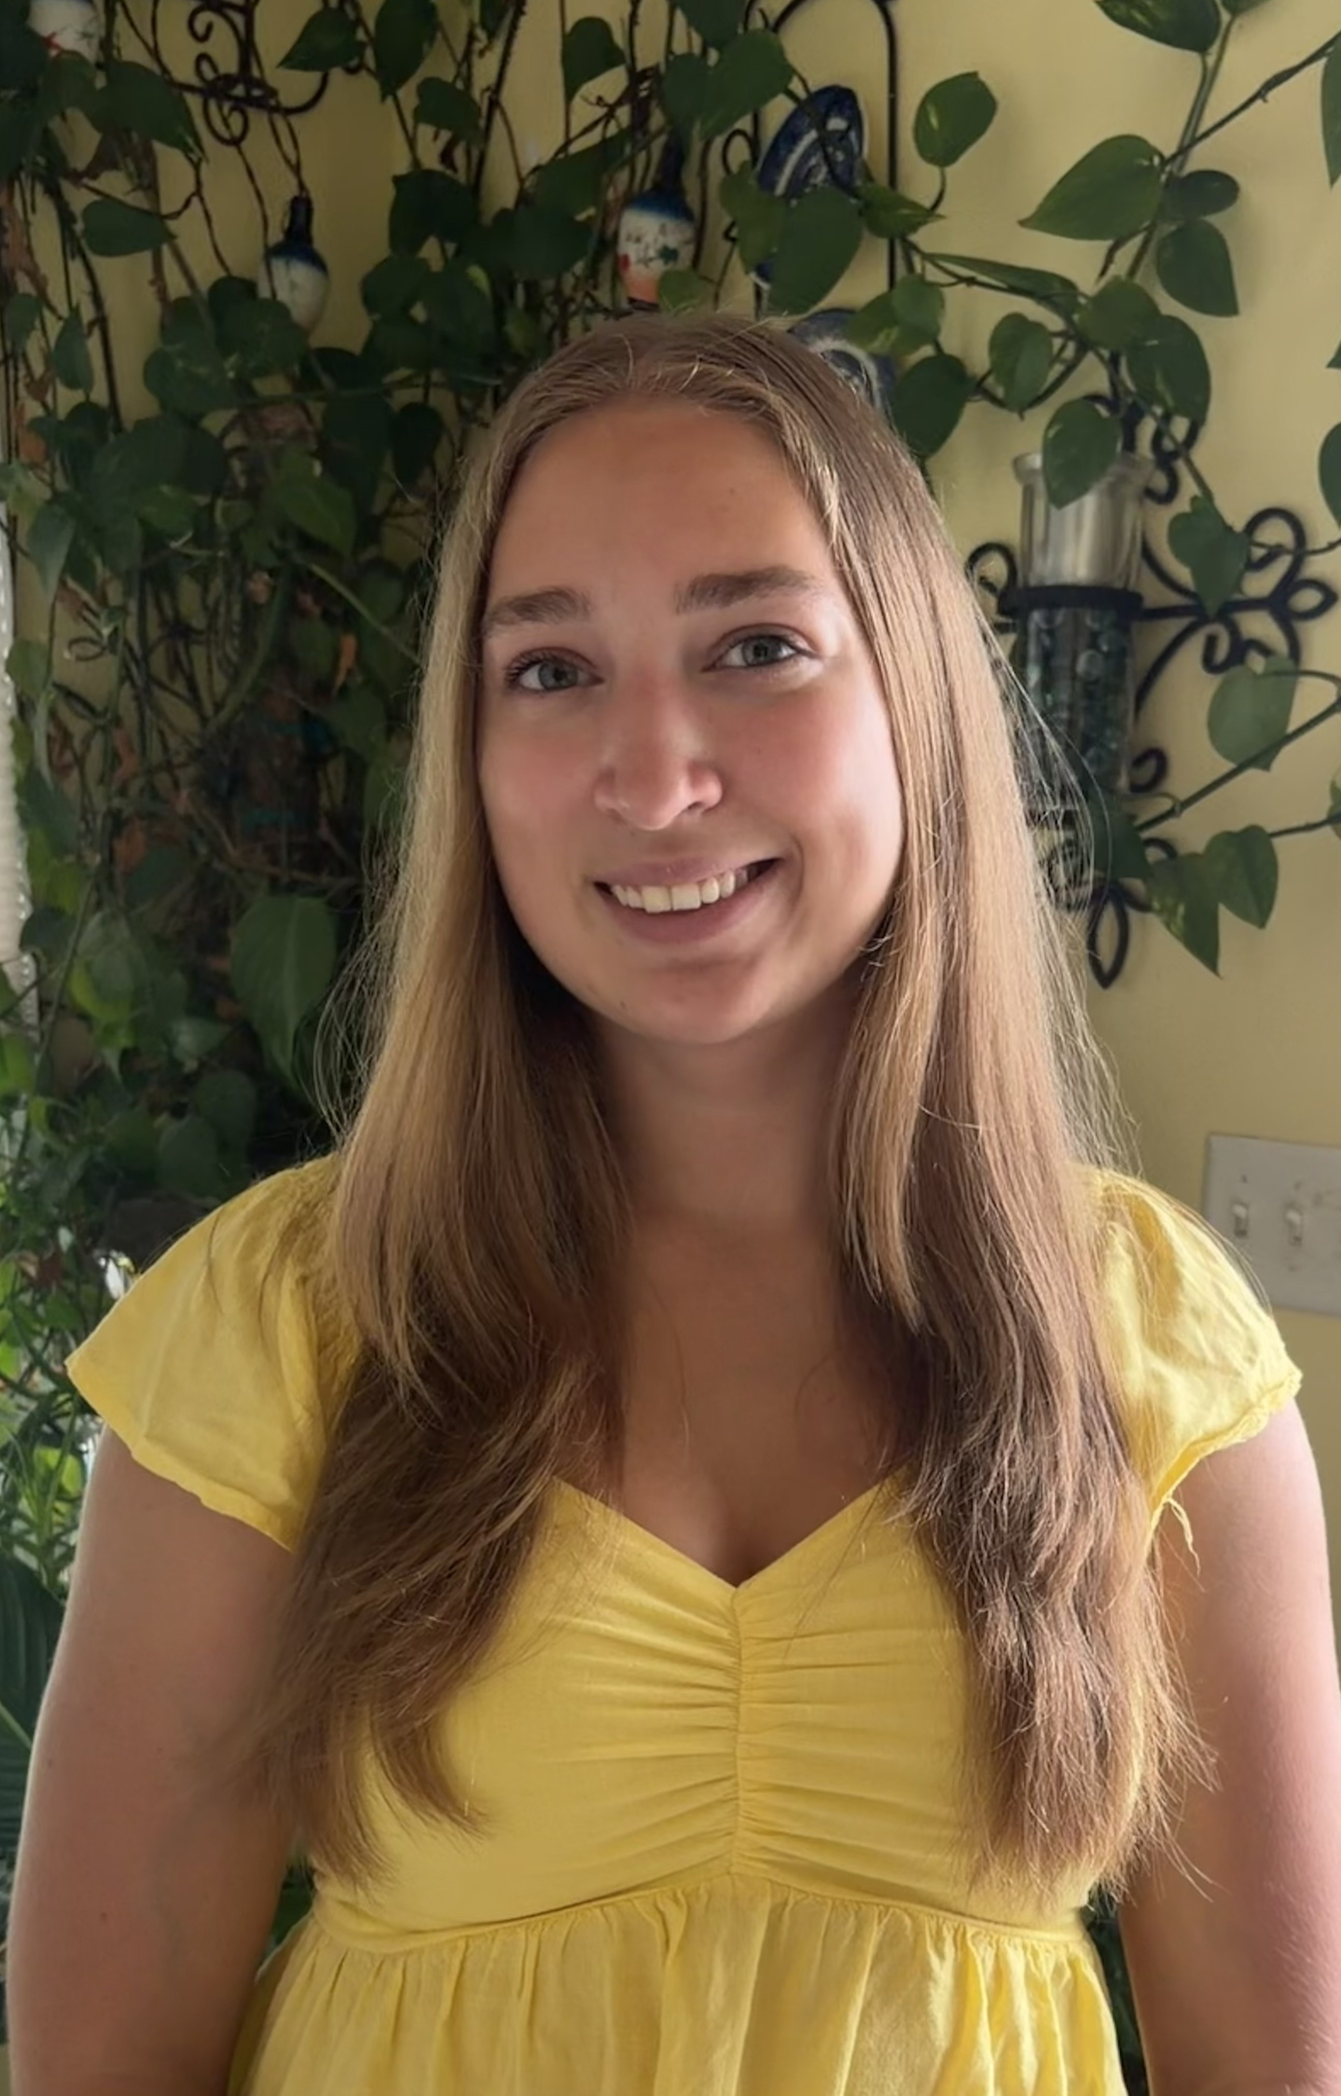
Scholarship Awardees • 27 of 40
Insert photo
Insert photo
Clay Miller
Cecilia Miller
University of Alabama
William Paterson University

Slide 29


Scholarship Awardees • 28 of 40
Insert photo
Insert photo
Patrick Neal
Rayden Neff
University of Texas-Arlington
Wichita State University

Slide 30


Scholarship Awardees • 29 of 40
Insert photo
Insert photo
Rebecca Opperman
Grant Orvik
Millersville University
Northern Arizona University

Slide 31


Scholarship Awardees • 30 of 40
Insert photo
Insert photo
Matthew Parker
Addison Petitt
Gonzaga University
Life University

Slide 32


Scholarship Awardees • 31 of 40
Insert photo
Insert photo
Max Porter
Edmund Preuschoff
Coastal Carolina University
Whitworth University

Slide 33


Scholarship Awardees • 32 of 40
Insert photo
Insert photo
Greyson Pyatt
Bridgette Reid
Penn State University
Penn State-Abington

Slide 34

Scholarship Awardees • 33 of 40
Insert photo
Insert photo
Calvin Reid
Samuel Reiss
Hudson Valley Community College
NC State University

Slide 35


Scholarship Awardees • 34 of 40
Insert photo
Insert photo
Oliver Scott
Kiersten Smith
University of New Hampshire
NOVA Southeastern University

Slide 36


Scholarship Awardees • 35 of 40
Insert photo
Insert photo
Sophie Swan
Caleb Terrell
Mississippi College
Cal Poly State University, San Luis Obispo

Slide 37


Scholarship Awardees • 36 of 40
Insert photo
Insert photo
Riley Turner
Orin Turner
University of New Mexico-Valencia
Eastern New Mexico University

Slide 38


Scholarship Awardees • 37 of 40
Insert photo
Insert photo
Emily VanWormer
Matthew VanWormer
Sam Houston State University
University of Nebraska-Lincoln

Slide 39


Scholarship Awardees • 38 of 40
Insert photo
Insert photo
Colby Ward
Kylie Ward
University of Tennessee-Knoxville
University of Tennessee-Chattanooga

Slide 40


Scholarship Awardees • 39 of 40
Insert photo
Insert photo
Kate Woods
Corbin Wright
SUNY-Geneseo
Misericordia University

Slide 41


Scholarship Awardees • 40 of 40
Insert photo
Insert photo
Miriam Youel
Lauryn Zlotucha
University of Connecticut
University of Utah

